Slide 1
Geography – strategies for success!
Internet geography – for your case study information
Sunday morning coffee videos –
to revise
Past papers -
to practice

Slide 2
Paper 1 section A - Natural hazards |  | Revised?
Key idea | Specification content
Natural hazards pose major risks to people and property. | Definition of a natural hazard. Types of natural hazard. Factors affecting hazard risk.
Earthquakes and volcanic eruptions are the result of physical processes. | Plate tectonics theory. Global distribution of earthquakes and volcanic eruptions and their relationship to plate margins. Physical processes taking place at different types of plate margin (constructive, destructive and conservative) that lead to earthquakes and volcanic activity.
The effects of, and responses to, a tectonic hazard vary between areas of contrasting levels of wealth. | Primary and secondary effects of a tectonic hazard. Immediate and long-term responses to a tectonic hazard. Use named examples to show how the effects and responses to a tectonic hazard vary between two areas of contrasting levels of wealth. (L’AQUILA 2009/NEPAL 2015)
Management can reduce the effects of a tectonic hazard. | Reasons why people continue to live in areas at risk from a tectonic hazard. How monitoring, prediction, protection and planning can reduce the risks from a tectonic hazard.
Global atmospheric circulation helps to determine patterns of weather and climate. | General atmospheric circulation model: pressure belts and surface winds.
Tropical storms (hurricanes, cyclones, typhoons) develop as a result of particular physical conditions. | Global distribution of tropical storms (hurricanes, cyclones, typhoons). An understanding of the relationship between tropical storms and general atmospheric circulation. Causes of tropical storms and the sequence of their formation and development. The structure and features of a tropical storm. How climate change might affect the distribution, frequency and intensity of tropical storms.
Tropical storms have significant effects on people and the environment. | Primary and secondary effects of tropical storms. Immediate and long-term responses to tropical storms. Use a named example of a tropical storm to show its effects and responses. (TYPHOON HAIYAN 2013) How monitoring, prediction, protection and planning can reduce the effects of tropical storms.
The UK is affected by a number of weather hazards. | An overview of types of weather hazard experienced in the UK.
Extreme weather events in the UK have impacts on human activity. | An example of a recent extreme weather event in the UK to illustrate: (SOMERSET LEVEL FLOODS 2013/14) causes social, economic and environmental impacts how management strategies can reduce risk. Evidence that weather is becoming more extreme in the UK.
limate change is the result of natural and human factors, and has a range of effects. | Evidence for climate change from the beginning of the Quaternary period to the present day. Possible causes of climate change: natural factors – orbital changes, volcanic activity and solar output human factors – use of fossil fuels, agriculture and deforestation. Overview of the effects of climate change on people and the environment.
Managing climate change involves both mitigation (reducing causes) and adaptation (responding to change). | Managing climate change: mitigation – alternative energy production, carbon capture, planting trees, international agreements adaptation – change in agricultural systems, managing water supply, reducing risk from rising sea levels.

Slide 3
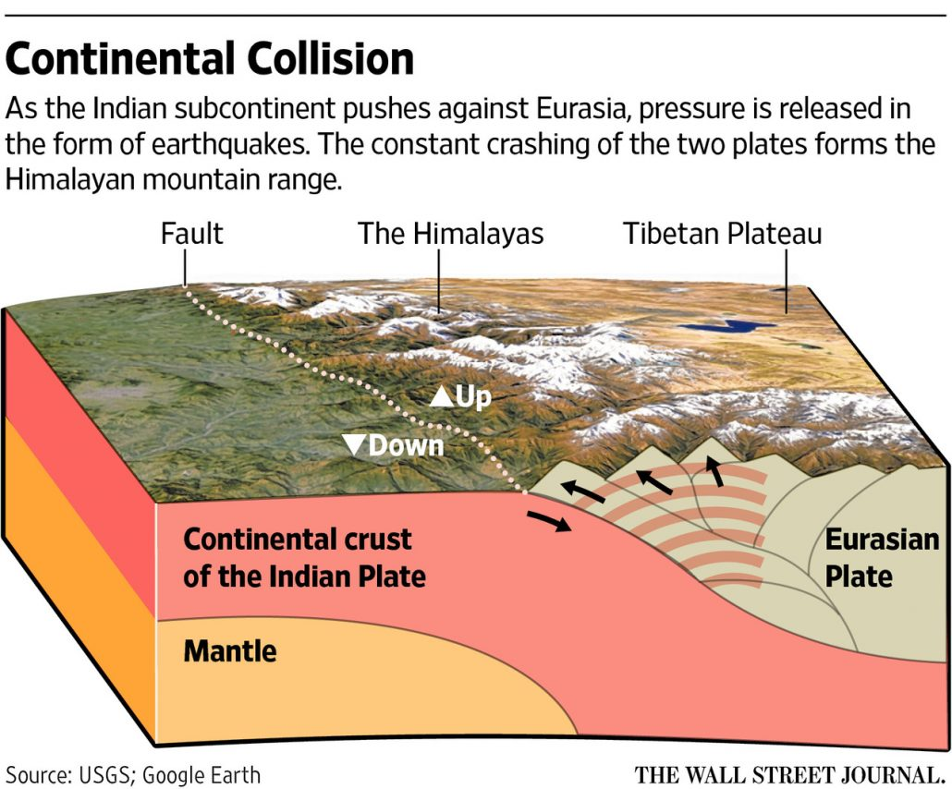
Nepal 2015 (tectonic hazard – earthquake)
Nepal, one of the poorest countries in the world, is a low-income country. Nepal is located between China and India in Asia along the Himalayan Mountains.
At 11.26 am on Saturday, 25th of April 2015, a magnitude 7.9 earthquake struck Nepal. The focus was only eight kilometres deep, and the epicentre was just 60 kilometres northwest of Kathmandu, the capital city of Nepal.
WHAT CAUSED THE NEPAL EARTHQUAKE?
The earthquake occurred on a collision plate boundary between the Indian and Eurasian plates.
WHAT WERE THE PRIMARY EFFECTS OF THE 2015 EARTHQUAKE IN NEPAL?
8841 died, and 19,000 people were injured – over 8 million people were affected.
Three million people were made homeless.
1.4 million people needed support with access to water, food and shelter in the days and weeks after the earthquake
Seven thousand schools were destroyed.
50% of shops destroyed
The secondary effects of the 2015 earthquake in Nepal include:
Avalanches and landslides were triggered by the quake, blocking rocks and hampering the relief effort.
At least nineteen people lost their lives on Mount Everest due to avalanches
WHAT WERE THE IMMEDIATE RESPONSES TO THE NEPAL EARTHQUAKE?
India and China provided over $1 billion of international aid.
Over 100 search and rescue responders, medics and disaster and rescue experts were provided by The UK, along with three Chinook helicopters for use by the Nepali government.
The GIS tool “Crisis mapping” was used to coordinate the response.
Aid workers from charities such as the Red Cross came to help.
WHAT WERE THE LONG-TERM RESPONSES TO THE NEPAL EARTHQUAKE?
A $3 million grant was provided by The Asian Development Bank (ADB) for immediate relief efforts and up to $200 million for the first phase of rehabilitation.
Many countries donated aid. £73 million was donated by the UK (£23 million by the government and £50 million by the public). In addition to this, the UK provided 30 tonnes of humanitarian aid and eight tonnes of equipment.
Landslides were cleared, and roads were repaired.
Lakes that formed behind rivers damned by landslides were drained to avoid flooding.
Stricter building codes were introduced.

Slide 4
L’Aquila 2009 (tectonic hazard – earthquake)
On 6 April 2009, a magnitude 6.3 earthquake struck L’Aquila in central Italy, killing 309 people. The main shock happened in the early morning hours at 3.32 am when most people were sleeping, extensively damaging the 13th-century city of L’Aquila, located only about 60 miles (100 km) northeast of Rome.
Primary effects:
309 people died and 1500 people were injured
65000 people were made homeless
10000-15000 buildings collapsed
The hospital was badly damaged
The estimated cost of the earthquake was US$16 billion
Secondary effects:
Access to some areas of the city was restricted due to unsafe buildings
Transport was damaged due to landslides and rock falls
University applications have declined for the University of L’Aquila
Immediate responses:
Homeless people were provided with tents and hotel rooms
Bills and mortgages for those affected were suspended
The EU provided US$552.9 million from its major disaster fund
£170 million was raised by the British Red Cross
The DEC did not provide any aid. This is because Italy is a HIC
Secondary effects:
No taxes were paid by the residents of L’Aquila during 2010
To encourage students back to the University fees were dropped for 3 years
A memorial procession is held on the anniversary of the earthquake

Slide 5
Typhoon Haiyan (2013)
Typhoon Haiyan, a category five typhoon, struck the Philippines on 8th November, 2013 at 4.40 am. The tropical storm originated in the northwest Pacific Ocean. It is one of the most powerful typhoons to affect the Philippines. Wind speeds of 314 kilometres per hour (195 miles per hour) were recorded. 400 millimetres of heavy rainfall and 90% of Tacloban was destroyed.
The primary effects of Typhoon Haiyan were:
The overall cost of damage was around $12 billion
Leyte and Tacloban experienced a 5-metre storm surge, and 400mm of rainfall flooded an area of up to 1km inland
90% of Tacloban was destroyed
6300 people died
4.1 million people were made homeless
What were the secondary effects?
Survivors fought for food and supplies. Eight people died in a stampede for food supplies.
Seawater, chemicals and sewerage contaminated surface and groundwater.
An oil tanker ran aground, causing an 800,000-litre oil leak that contaminated fishing waters.
What were the immediate responses?
Eight hundred thousand people were evacuated following a televised warning by the president. Many people found refuge in a stadium in Tacloban. However, many people died when it was flooded. The government provided essential equipment and medical supplies. A curfew was introduced two days after the typhoon to reduce looting.
Three days after the storm, the main airport was reopened, and emergency aid arrived. Power was restored in some regions after a week. One million food packs and 250,000 litres of water were distributed within two weeks.
Over $1.5 billion of foreign aid was pledged. Thirty-three countries and international organisations promised help, with rescue operations and an estimated US $ 88.871 million.
What were the long-term responses?
Build Back Better is the government’s response to the typhoon. Launched in 2014, it intended to upgrade damaged buildings to protect them from future disasters. They have also set up a no-build zone along the coast in Eastern Visayas, a new storm surge warning system has been developed, and mangroves replanted to absorb future storm surges.

Slide 6
The Somerset Levels Flood Case Study
The Somerset Levels are a coastal plain and wetland area in Somerset, England. Thousands of years ago, the area was covered by the sea, but today it’s a landscape of rivers and wetlands – artificially drained, irrigated and modified to allow productive farming.
It is claimed that the Somerset Levels are one of the lowest areas in the UK. This is because much of the area lies below the high-water mark of spring tides. The area is very flat and has a maximum altitude of 8m above sea level. All rivers in this area, including Axe, Sheppey and Brue, are in the north, while to the south, the rivers the Cary, Yeo, Tone and Parrett drain into the Bristol Channel.
In January 2014, the Somerset Levels experienced floods greater than any other in living memory. Estimates suggest that 10% of the area was underwater when the flooding was greatest.
WHAT WERE THE PHYSICAL CAUSES OF FLOODING IN THE SOMERSET LEVELS?
A quick succession of prolonged Atlantic storms, with persistent rainfall and gale-force winds, was the primary cause of flooding. The rivers could not cope with the significant amount of rain that fell. High tides in the Bristol Channel and its narrowing also create tidal surges. These blocked the floodwater, trying to escape the Somerset Levels. Coastal defences coped with the tidal surges.
WHAT WERE THE HUMAN CAUSES OF FLOODING IN THE SOMERSET LEVELS?
There had been less dredging of the river channels on the Somerset Levels leading up to 2014. However, as a result, the channels had risen due to sediment accumulation. This reduced the capacity of rivers to transport water, leading to flooding.
Change in farming practices has also contributed to flooding. Much of the land has been converted from grassland to grow maise. This more intensive use of the land means it is less able to retain water, causing it to run over the surface rather than being absorbed.
What were the social impacts of the Somerset Levels floods?
Over 600 homes and 16 farms were evacuated, resulting in many people requiring temporary accommodation, where many stayed for several months. In addition, several villages, such as Moorland and Muchelney, were cut off after roads were flooded. Power supplies were cut off during a time when temperatures were low.
What were the economic impacts of the Somerset Levels floods?
Somerset County Council estimates that the cost of flood damage was over £10 million. The agricultural industry was among the hardest hit, with over fourteen thousand hectares of agricultural land used for crops and grazing flooded for three to four weeks. One thousand livestock were evacuated from the affected farms.
Many main roads were closed, including the A361 linking Taunton and Street. Flooding disrupted train services on the main Bristol line between Taunton and Bridgwater.
Fuel used to power emergency pumps cost £200 000 per week. An estimated £1 million was lost by local businesses. The Somerset floods cost the county’s tourism industry an estimated £200 million.
What were the environmental impacts of the Somerset Levels floods?
The environmental impact included the extensive contamination of floodwaters by sewage, oil, and various chemical pollutants. Following the recession of floodwaters, a significant amount of debris required clearing, while stagnant water accumulated over several months needed to be re-oxygenated before reintroduction into rivers. Failure to do so would have caused substantial harm to marine ecosystems.
The soil was damaged after being underwater for nearly three months. In some areas, it took over two years to restore the soil before crops could be grown.
IMMEDIATE RESPONSE TO THE SOMERSET LEVELS FLOOD
As expected for a high-income country (HIC), the response to the flood was well-organised and rapid.
Local people in South West England were warned of heavy rain when the Met Office issued an amber warning. The public was advised to prepare for significant flooding by the Environmental Agency. Many people used sandbags to protect their property and moved valuable items upstairs. In Moorland, a man constructed a large wall out of clay and mud to protect his house from flooding.
Rescue boats were used to help stranded people by the fire brigade who also visited hundreds of properties. Rescue crews supported residents of Moorland in evacuating. The owners of some 80 homes agreed to evacuate; however, around 30 residents stayed at home. Additional police patrols were introduced as a result of increased crime.
The army was sent into the area with specialist equipment towards the end of January. They issued sandbags and distributed food. 40 Royal Marines later joined them to provide additional support.
Sixty-five pumps were used to drain 65 million m3 of floodwater.
Local people, led by the Flooding on the Levels Action Group (FLAG), provided local support to the people affected. This included fundraising and the collection and distribution of food. They also used social media, such as Facebook and Twitter, to share the news.
The government made an estimated £15m to meet the immediate costs of protecting lives and properties.
LONG-TERM RESPONSE TO THE SOMERSET LEVELS FLOOD
The long-term response to the Somerset Levels flood focussed on management techniques to reduce the risk of future floods. As a result, the Somerset Levels and Moors Action Plan was developed and included measures such as reintroducing dredging, constructing a tidal barrage and additional permanent pumping stations. The scheme is part of a 20-year plan for the Somerset Levels and will total £100 million.

Slide 7
Assess the extent to which primary impacts are more significant than secondary impacts in a tectonic hazard (9 marks + 3 SPaG)
Top Tip: Connectives are words that help you develop your answers. Try using CATTS to help you! Consequently… As a result… This means that… Therefore… So this means that
Point (introduce the paragraph and link to question) | Evidence (be specific) | Explanation | Link
One reason I think that primary impacts are more significant than secondary impacts is because without a primary impact a secondary impact wouldn’t occur. | This is shown in the L’Aquila earthquake where 10,000 buildings collapsed. | As a result, this led to 40,000 people being homeless. | Therefore, this shows that the primary impacts are more significant than the secondary impacts following an earthquake.
Another reason why I think the primary impacts are more significant is because it leads to irreparable damage such as deaths. | A total of 309 people died due to the L’Aquila earthquake in 2009. | This means that… | Therefore, this shows that primary impacts are more significant than the secondary impacts following an earthquake.
However, it could be argued that the secondary impacts of an earthquake are more significant than primary impacts, is because they are longer lasting. | 1.4 million people needed support with access to water, food and shelter in the days and weeks after the earthquake | As a result…
Conclusion

Slide 8
‘Long term responses are more effective at reducing the effects of tropical storms than immediate responses.’ To what extent do you agree with this statement? (9 marks + 3 SPaG)
Top Tip: Connectives are words that help you develop your answers. Try using CATTS to help you! Consequently… As a result… This means that… Therefore… So this means that
Point (introduce the paragraph and link to question) | Evidence (be specific) | Explanation | Link
I think that long term responses are more effective at reducing the impacts of tropical storms than immediate responses because they can minimize the impacts of future tropical storms. | This is demonstrated following Typhoon Haiyan which struck the Philippines in November 2013. In response to the tropical storm, the government created the ‘Build Back Better’ scheme to rebuild destroyed buildings. | This was an effective response as it helped many people rebuild their homes in the aftermath of the typhoon. Homes were rebuilt to withstand future tropical storms, which will minimize the number of homes destroyed in future tropical storm events. | Therefore, this is an effective long term response which reduces the impacts of tropical storms.
However, immediate responses are also hugely important in reducing the impacts of a tropical storm as they can save lives and minimise the death toll. | Following Typhoon Haiyan, there were a range of immediate responses such as a televised warning which caused 800,000 people to evacuate. In addition, the government evacuated locals to the Tacloban indoor stadium.
 | In the days following Typhoon Haiyan, the main airport was reopened which allowed emergency aid to arrive. This included one million food packs and 250,000 litres of water.
Conclusion

Slide 9
‘Managing climate change involves both mitigation (reducing causes) and adaptation (responding to change)’. Do you agree? Explain your answer (9 marks + 3 SPaG)
Top Tip: Connectives are words that help you develop your answers. Try using CATTS to help you! Consequently… As a result… This means that… Therefore… So this means that
Point (introduce the paragraph and link to question) | Evidence (be specific) | Explanation | Link
Mitigation and adaptation are both important to reduce the effects of climate change. Mitigation reduces the causes, to which there are a variety of effective methods. One strategy is through international agreements. | For example, the Paris Agreement was founded in 2015, where 195 countries signed a legally binding document to keep global temperature increase below 2 degrees Celsius. | This means that, countries around the world are working together to take important steps to reduce the causes of climate change and therefore reduce the impacts of climate change. | Therefore, this shows that mitigation is an important part of managing climate change.
Another important method of reducing the causes of climate change is the use of alternative energy production such as solar, wind and nuclear. | For example, in the UK in 2021, renewable energy accounted for more than 43% of the energy generated.
However, it is also hugely important to adapt to the changes that are caused by climate change. One change is sea level rise, which is a particular issue for lowlying island nations such as the Maldives. | The Maldives are at risk of being uninhabitable by 2050 due to rising sea levels. To manage this the government are using a range of strategies such as building houses on stilts, constructing sea walls and restoring mangrove forests along the coastline.
Conclusion

Slide 10
Paper 1 Section C – physical landscapes in the uk – rivers
Key idea | Specification content
The UK has a range of diverse landscapes. | An overview of the location of major upland/lowland areas and river systems.
The shape of river valleys changes as rivers flow downstream. | The long profile and changing cross profile of a river and its valley. Fluvial processes: erosion – hydraulic action, abrasion, attrition, solution, vertical and lateral erosion transportation – traction, saltation, suspension and solution deposition – why rivers deposit sediment.
Distinctive fluvial landforms result from different physical processes. | Characteristics and formation of landforms resulting from erosion – interlocking spurs, waterfalls and gorges. Characteristics and formation of landforms resulting from erosion and deposition – meanders and ox-bow lakes. Characteristics and formation of landforms resulting from deposition – levées, flood plains and estuaries. An example of a river valley in the UK to identify its major landforms of erosion and deposition. (River Tees)
Different management strategies can be used to protect river landscapes from the effects of flooding. | How physical and human factors affect the flood risk – precipitation, geology, relief and land use. The use of hydrographs to show the relationship between precipitation and discharge. The costs and benefits of the following management strategies: hard engineering – dams and reservoirs, straightening, embankments, flood relief channels soft engineering – flood warnings and preparation, flood plain zoning, planting trees and river restoration. An example of a flood management scheme in the UK to show: (Jubilee River) why the scheme was required the management strategy the social, economic and environmental issues.

Slide 12
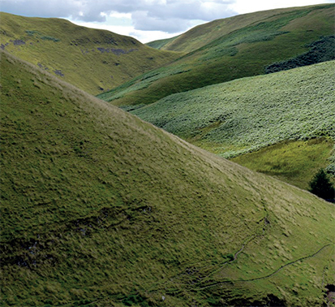
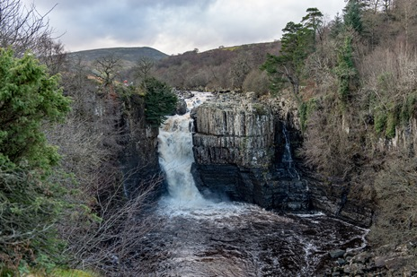
Study the figure below, a photograph taken in the upper course of the river and its valley.
Study the photograph showing the waterfall at High Force on the River Tees.

Slide 13
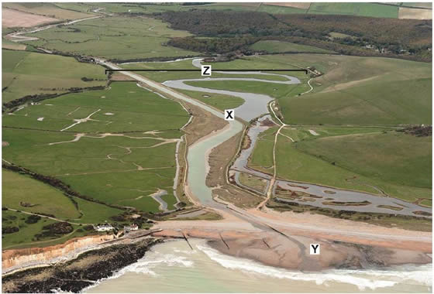
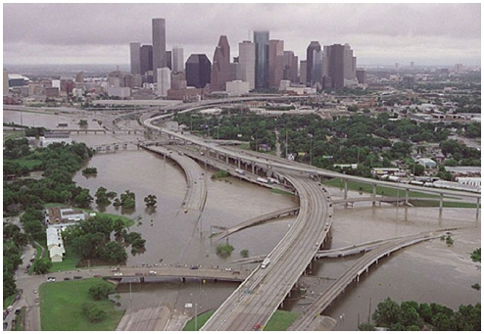
Explain how a meander may be formed by both erosion and deposition.
Use one or more diagrams to support your answer.
Feature Z labelled on the photograph above is a floodplain.
Explain the formation of a floodplain.
____________________________________________________________________________________________________________________________________________________________________________
_____________________________________________________________________________________________________________________________________________________________________________________________________________________________________________________________________________________________________________(4 marks)
Study the photograph showing urban flooding.
With the help of the photograph, explain how physical and human factors can increase the risk of river flooding.
______________________________________________________________________________________________________________________________________________________________________________________________________________________________________________________________________________
____________________________________________________________________________________________________________________________________________________________________________________________________________________________________________________________________________________________________________________________________________________________________________________________________________________________________________________________________________________________________________________________________________________________ (6 marks)

Slide 14
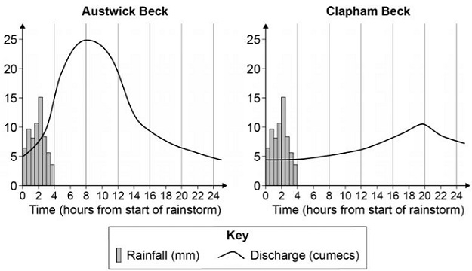
Study the flood hydrographs below for two different streams after the same storm.
‘Differences in the shape of flood hydrographs are caused by both human and physical factors.’
Do you agree?
Use the flood hydrographs and your own understanding to explain your answer.
________________________________________________________________________________________________________________________________________________________________________________________________________________________________________________________________________________________________________________________________________________________________________________________________________________________________________________________________________________________________________________________________________________________________________________________________________________________________________________________________________________________________________________________________________________________________________________________________________________________________________________________(6 marks)
Assess the benefits of using hard engineering and soft engineering to reduce the risk of river flooding.
Use the figure above and your own understanding.
_______________________________________________________________________________________________________________________________________________________________________________________________________________________________________________________________________________________________________________________________________________________________________________________________________________________________________________________________________________________________________________________________________________________________________________________________________________________________________________________________________________________(6 marks)

Slide 15
Paper 2 Section b – Changing economic world
Key idea | Specification content
There are global variations in economic development and quality of life. | Different ways of classifying parts of the world according to their level of economic development and quality of life. Different economic and social measures of development: gross national income (GNI) per head, birth and death rates, infant mortality, life expectancy, people per doctor, literacy rates, access to safe water, Human Development Index (HDI). Limitations of economic and social measures. Link between stages of the Demographic Transition Model and the level of development. Causes of uneven development: physical, economic and historical. Consequences of uneven development: disparities in wealth and health, international migration.
Various strategies exist for reducing the global development gap. | An overview of the strategies used to reduce the development gap: investment, industrial development and tourism, aid, using intermediate technology, fairtrade, debt relief, microfinance loans. An example of how the growth of tourism in an LIC or NEE helps to reduce the development gap. (Jamaica)
Some LICs and NEEs are experiencing rapid economic development which leads to significant social, environmental and cultural change. | A case study of one LIC or NEE to illustrate: (Nigeria) the location and importance of the country, regionally and globally the wider political, social, cultural and environmental context within which the country is placed the changing industrial structure. The balance between different sectors of the economy. How manufacturing industry can stimulate economic development the role of transnational corporations (TNCs) in relation to industrial development. Advantages and disadvantages of TNC(s) to the host country the changing political and trading relationships with the wider world international aid: types of aid, impacts of aid on the receiving country the environmental impacts of economic development the effects of economic development on quality of life for the population.
Major changes in the economy of the UK have affected, and will continue to affect, employment patterns and regional growth. | Economic futures in the UK: causes of economic change: de-industrialisation and decline of traditional industrial base, globalisation and government policies moving towards a post-industrial economy: development of information technology, service industries, finance, research, science and business parks impacts of industry on the physical environment. An example of how modern industrial development can be more environmentally sustainable social and economic changes in the rural landscape in one area of population growth and one area of population decline improvements and new developments in road and rail infrastructure, port and airport capacity the north–south divide. Strategies used in an attempt to resolve regional differences the place of the UK in the wider world. Links through trade, culture, transport, and electronic communication. Economic and political links: the European Union (EU) and Commonwealth.

Slide 16
Evaluate the effectiveness of tourism in reducing the development gap (9 marks + 3 SPaG)
Top Tip: Connectives are words that help you develop your answers. Try using CATTS to help you! Consequently… As a result… This means that… Therefore… So this means that
Point (introduce the paragraph and link to question) | Evidence (be specific) | Explanation | Link
Jamaica has suffered with debt and unemployment, tourism is one method which has helped to close the development gap by providing employment to locals. | In 2018, 1 in 4 jobs were in the tourist sector, particularly in the capital city Kingston and Montego Bay.
 | Local farmers are employed by large resorts to grow produce for hotels. For example, Sandals resort has provided more than $25million in assistance to local farmers.
 | Even with over 4.3 million tourists in Jamaica, a high portion of the profits go overseas to foreign businesses.
Conclusion

Slide 17
‘Transnational corporations (TNCs) only bring advantages to the host country.’ Do you agree with this statement? Justify your decision (9 marks + 3 SPaG)
Top Tip: Connectives are words that help you develop your answers. Try using CATTS to help you! Consequently… As a result… This means that… Therefore… So this means that
Point (introduce the paragraph and link to question) | Evidence (be specific) | Explanation | Link
Shell is a large TNC which operates in the country of Nigeria, it brings many advantages. One key advantage is that it provides a large amount of employment to a country previously dominated by agriculture. | Shell employs 65,000 Nigerian workers directly and 250,000 workers in related industries. | This means that local people are provided with jobs in the formal sector with a regular wage. This can then be spent in the local area generating a positive multiplier effect. | Therefore, this shows that Shell has positive impacts on the host country of Nigeria.
 | Shell contributes a huge amount in tax and export revenue in Nigeria, totalling over £20billion in 2013.
However, it can be argued that TNCs bring disadvantages to their host country due to environmental damage. | Shell has extracted over $30billion worth of crude oil from the land of the Ogoni people since 1950. This has damaged the local area for the Ogoni people, where land has been poisoned, fish stocks have depleted and there have been oil spills and fires.
Conclusion

Slide 18
Evaluate the success or likely success of one or more strategies to resolve regional differences in the UK (9 marks + 3 SPaG)
Top Tip: Connectives are words that help you develop your answers. Try using CATTS to help you! Consequently… As a result… This means that… Therefore… So this means that
Point (introduce the paragraph and link to question) | Evidence (be specific) | Explanation | Link
One strategy implemented to resolve the difference between the North-South divide is through the introduction of Enterprise Zones. | Since 2011 there have been 24 new Enterprise Zones created where there was previously limited economic growth. These zones have a business discount rate, have superfast broadband and can access financial grants. | This is beneficial to areas as it means businesses may move from London to northern towns to access the benefits provided by an Enterprise Zone. This creates jobs for locals and generates a positive multiplier effect. | This is extremely important in urban areas affected by deindustrialisation, showing that it is an effective strategy in helping to reduce the North-South divide.
However, many would argue that these Enterprise Zones have been in place for more than a decade, yet there is still a significant gap between the North and South. | In March 2024, the government has outlined a huge budget cut for the now 28 EZ.
However, HS2 is an extremely controversial project with many opposed to it, which would suggest it might not be that effective. | For example, the scheme is roughly £50bn over budget and the eastern branch to Leeds has now been cut.
Conclusion

