Slide 1
Strategies for Success
English Literature
Condensed notes and mind maps

Slide 2
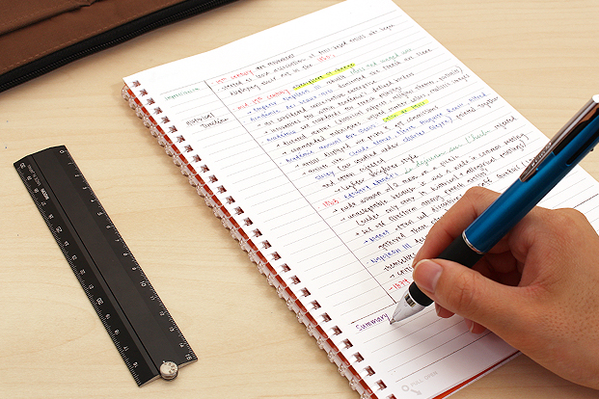
Using notes effectively
When making notes, start with the areas you feel the least confident in. It makes it easier to identify the gaps in your knowledge.
Your exercise books have your most detailed notes, you should be taking your books home to condense these notes.
Create sub-headings, use of key words and bullet points – the more concise the better!
Highlight the most important word in your note to support revision.

Slide 3
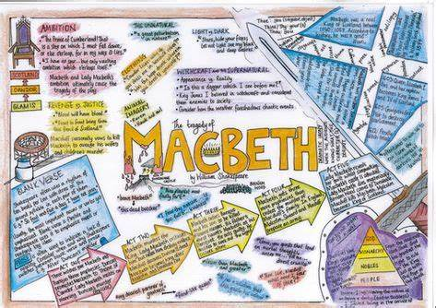
Mind maps
Mind maps are a great way to organise your notes and break down the key bits of knowledge you need for your exams
Again, create sub-headings and use of key words concisely
Colour-coding your sections can also be effective
Use of images can also help remember a key word/term/quotation

Slide 4
Resources and supporting at home

