Slide 1
Strategies for success in science.
There is a lot of content to remember.
40% of the paper can be accessed from recall, so you must be able to remember key facts and information.
Today we will use the knowledge organisers to improve how we can revise for recall.

Slide 2
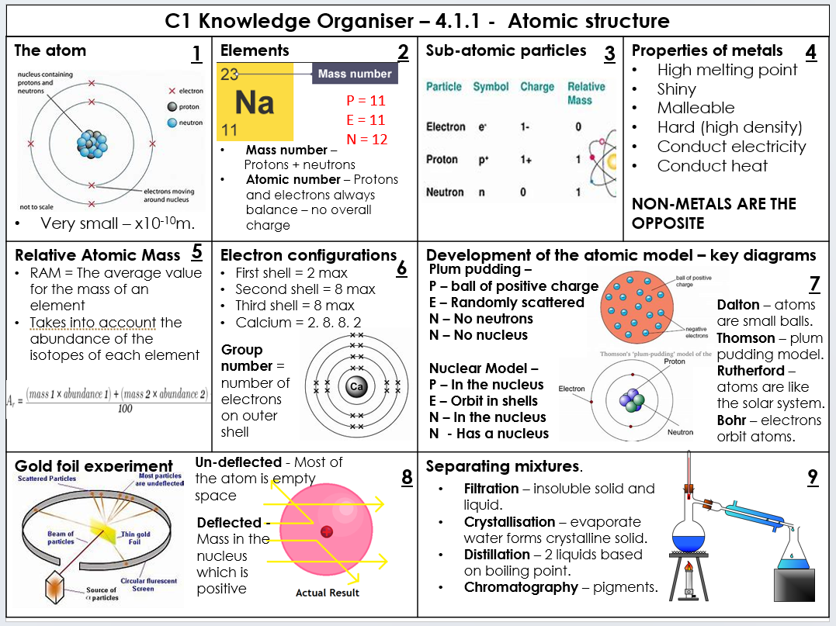
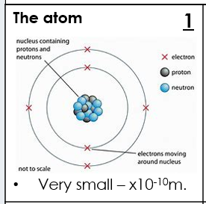
The topic title is at the top of the page to help organise your revision.
The page is divided into chucks of information to remember.
You can start by remembering one box at a time, then increase the number of boxes as you become more confident.
Images help to make the information stick.
Read the information, talk through the content so that you are hearing it as well as seeing it.
Now describe the image without looking at it.

Slide 3
Can the person you are describing it to draw it from your description alone?
Have a go on the whiteboards.
Check the accuracy of the diagrams
- does it contain protons and neutrons in the nucleus (centre)?
Does it contain two electron shells (rings) around the nucleus?
Are there two electrons (crosses) on the electron shell (ring) closest to the nucleus?
Are there four electrons on the outer electron shell?
Did you state the size of the atom?

Slide 4
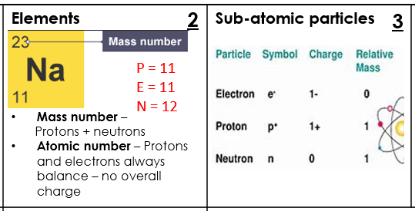
What about when there aren’t any nice diagrams to draw?
Box 2 and 3 have facts without images.
Start by talking through the information again so that you are hearing and seeing the information you have to remember.
Think of questions you could be asked about the information in box 2:
1)What is mass number?
2) What is atomic number?
3) What are the number of electrons always equal to?
4) How many protons does Na have?
5)How many electrons does Na have?
6) How many neutrons does Na have?
YOUR TURN TO THINK OF QUESTIONS FOR BOX 3 on your whiteboards, once you have the questions make sure you know the answers!

Slide 5
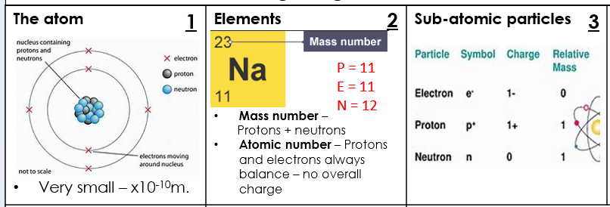
We’ve spent a few minutes on the facts above, maybe you managed to do more boxes in that time.
Now you are ready to use the next page of the booklet as a prompt to recall these facts.

Slide 6
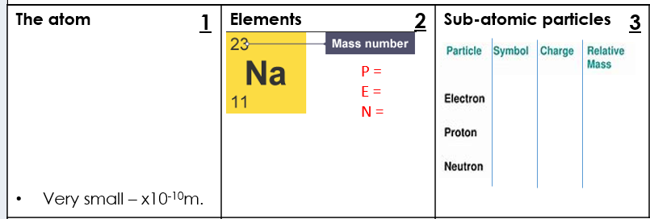
This page has the key facts removed, but I have left some prompts to help out.
Remember the diagram you drew for box 1?
Either complete in pencil so you can rub it out or complete on scrap paper.
Do the same for box two and three.

Slide 7
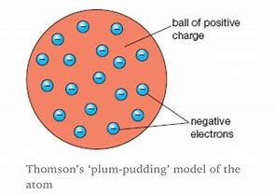
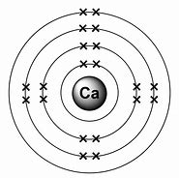
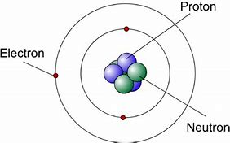
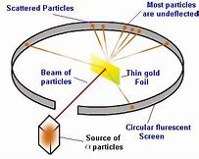
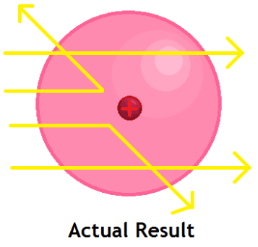
C1 Knowledge Organiser – 4.1.1 - Atomic structure
2
4
The atom Very small – x10⁻¹⁰m. | Elements | Sub-atomic particles | Properties of metals H S M H (high density) C C NON-METALS ARE THE ______________
Relative Atomic Mass ______ = The average value for the mass of an element Takes into account the ___________________________________________________________________________ | Electron configurations First shell = Second shell = Third shell = Calcium = | Development of the atomic model – key diagrams
Gold foil experiment |  | Separating mixtures.
1
3
P =
E =
N =
These pages are prompts for your memory, the better you get the fewer prompts you need and eventually you will be able to recall the information from just the title.
5
6
Plum pudding –
P –
E –
N –
N –
Nuclear Model –
P –
E –
N –
N -
7
Dalton – atoms are __________.
Thomson – _______________.
Rutherford – ______________________________.
Bohr – electrons orbit atoms at _______________
Group number = number of _________________________________
Un-deflected - __________________________________
8
9
_______________ – insoluble solid and liquid.
_______________ – evaporate water forms crystalline solid.
_______________ – 2 liquids based on boiling point.
________________ – pigments.
Deflected - _______________________________________________________

Slide 8
Question bank -

Slide 9
What next… applying to exam questions.
https://vuioset.exampro.net/

