Slide 1
Succeeding in Mathematics

Slide 2
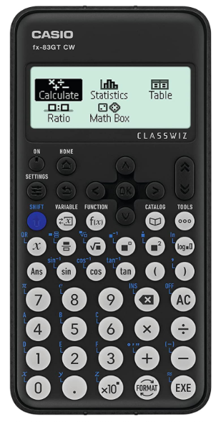
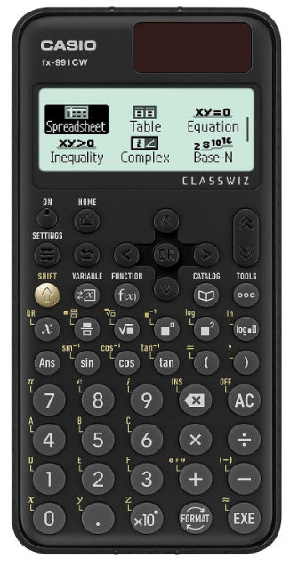
How can home help? - Calculators
$\frac{2}{3}$ of the final exam is on a calculator
$\frac{2}{3}$ of their written homework is on a calculator
The majority of their Sparx homework can be done on a calculator
Notes:
Keep

Slide 3
Taking responsibility for your learning
What should students be doing?
How can students help themselves?
Your exam
Your education
Your future
Notes:
Near the start

Slide 4
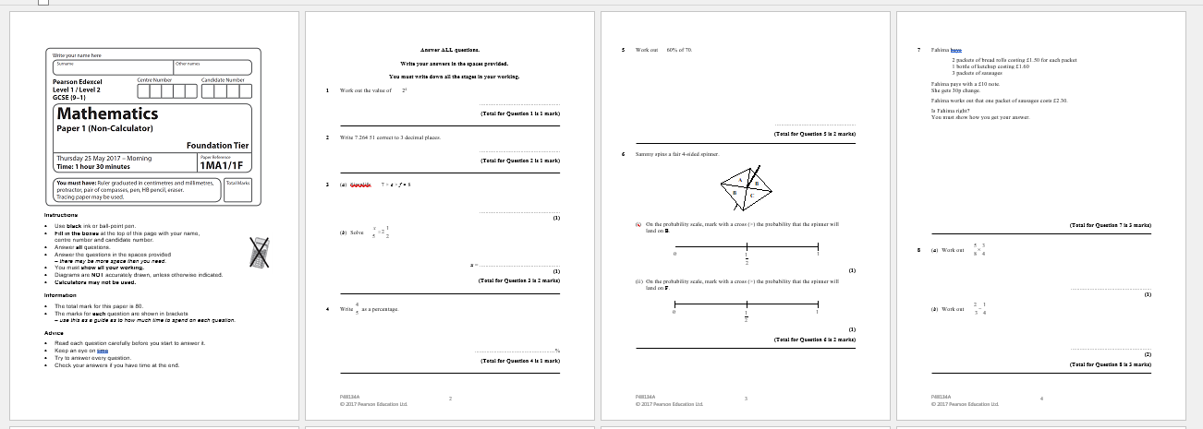
What we’re providing
Notes:
Keep but quickly

Slide 5
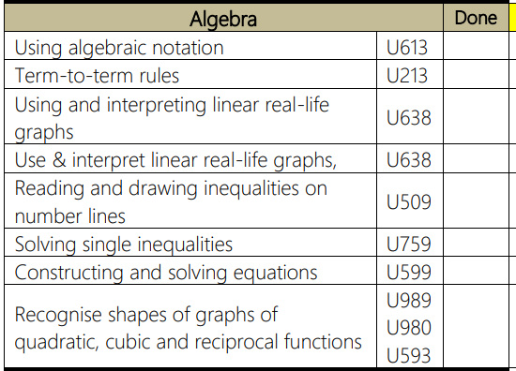
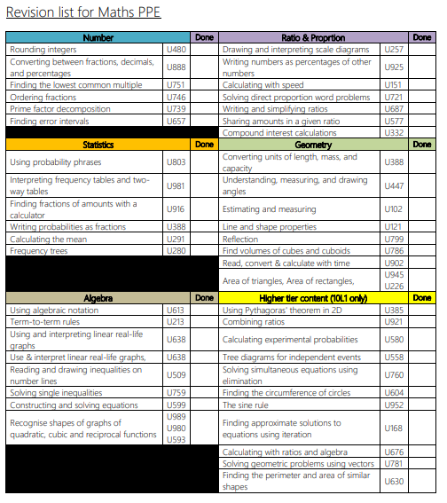
What we’re providing
Notes:
Keep but quickly

Slide 6
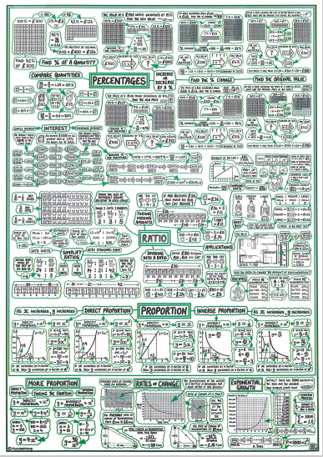
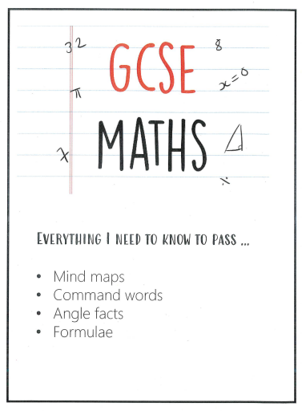
What we’re providing

Slide 7
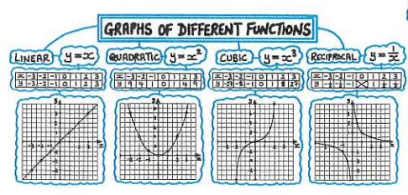
What we’re providing

