Slide 1
Personal Development
Parent/carer consultation

Slide 2
House keeping
Please help yourself to the refreshments
Ensure your mobile phone is on silent
We are not expecting the fire alarm do go off, in the event that it does sound we will direct you to the nearest exit
Please ask any questions or queries at the end

Slide 3
What is RSE?
RSE stands for relationships and sex education
Learning about the emotional, social and physical aspects of growing up
Relationships
Sex
Human sexuality
Sexual Health

Slide 4
Why do students need to cover RSE?
RSE provides accurate information about the body, reproduction, sex and sexual health
It gives children and young people essential skills for building positive, enjoyable, respectful and non-exploitive relationships and staying safe both on and offline

Slide 5
Our Aims
To deliver RSE in the context of a healthy school
To promote the health and wellbeing of students and of the whole school community
To have a positive influence on the ethos, learning and relationships throughout the school
To help students to develop the knowledge, understanding, skills and attitudes they need to live confident, healthy, independent lives now and in the future

Slide 6
The aim of RSE is NOT to:
Encourage young people to become sexually active at a young age
Promote a particular sexual orientation or gender identity
Sexualise young people

Slide 7
Why is RSE important?
High quality RSE helps create a safe school community in which our students can grow, learn and develop positive, healthy behaviour for life

Slide 8
How are we going to do this?
RSE is delivered as part of our comprehensive Personal Development curriculum
KS3 students (Years 7, 8 and 9) one lesson per week, KS4 (Years 10 and 11) one lesson a fortnight
It is developed by a team of PSHE professionals from the OAT trust
Additional content is delivered in tutor time and in assemblies
Staff training
Pastoral team have access to the lessons in advance
It is a reactive curriculum

Slide 9
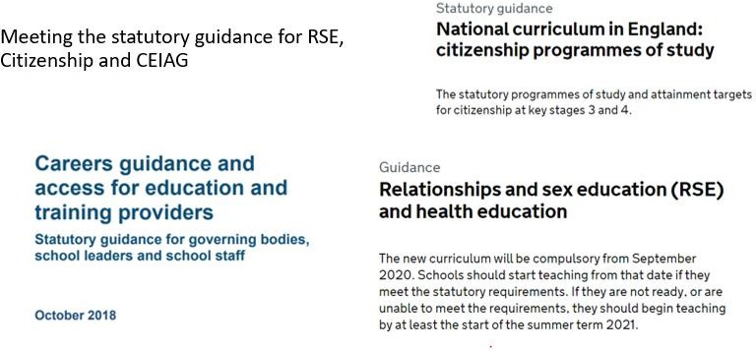
How are we going to do this?

Slide 10
How are we going to do this?
Being proactive within our local contexts examining the safeguarding and PHE trends
Regular parent and student surveys to assess content relavance

Slide 11
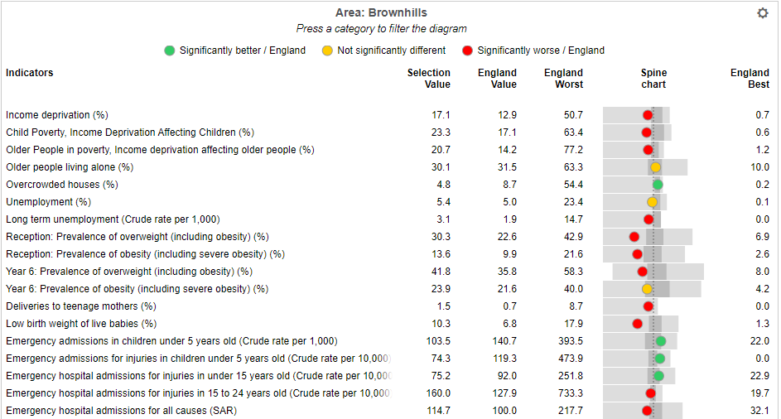
Health data for the Brownhills area

Slide 12
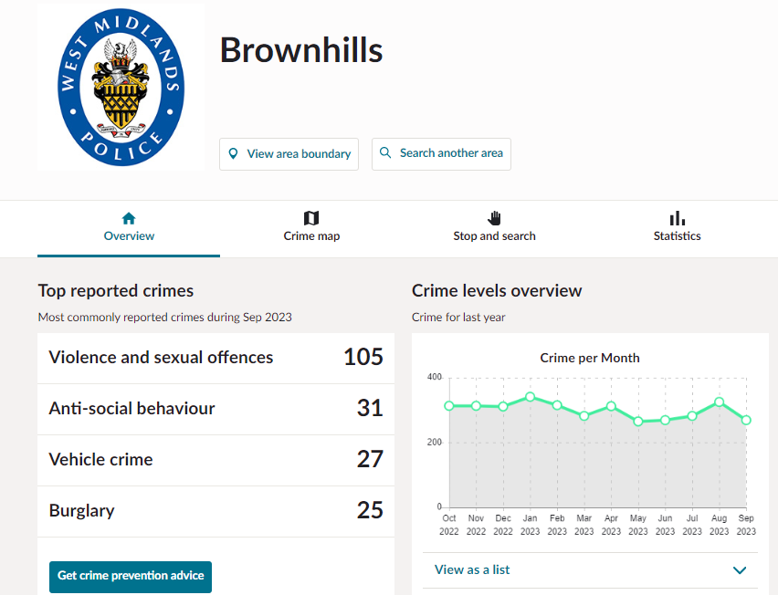
Crime data for the Brownhills area

Slide 13
Long Term Plan
Year 7
My New School – Settling In
My Friends – Friendship & Bullying
My World - Diversity and equality
My Life – Healthy Living & Relaxation
My Life – Keeping myself safe
My World – British Society & Democracy
Year 9
Media literacy
Diversity and equality
My finances and the future
Digital safety
Consent, conception & contraception
Managing my health
Year 11
My next steps
Resilience and readiness
My financial future
Digital safety
Study Skills & Active Revision
Year 8
Self Esteem & Identity
Healthy Relationships
Crime and criminality
Drugs, Alcohol & Healthy living
Diversity & Equality
Money Skills
Year 10
Managing my health
Relationships & Sex Education
Diversity and equality
PSHE 2023-24 overview.xlsx (sharepoint.com)

Slide 14
The role of parents and carers
The role of parents in the development of their children’s understanding about relationships is vital
Parents are the first teachers of their children
They have the most significant influence in enabling their children to grow and mature to form healthy, safe relatiosnhips

Slide 15
The role of parents and carers
The school will:
Work closely with parents and carers when planning and delivering RSE
Ensure that parents know what is being taught and when, and clearly communicate the fact that parents have the right to request that their child be withdrawn, up to the child’s 16th birthday from some or all of the sex education delivered as part of the statutory RSE Brownhills Ormiston Academy - Policies (brownhillsoa.co.uk)
Give parents the opportunity to ask questions about the schools approach and help increase confidence in the curriculm
Encourage parents to create an open home environment where pupils can engage, discuss and continue to learn about matters that have been raised through RSE.

Slide 16
Supporting all students
Responding to students’ diverse learning needs:
Considerations will be made for:
Religious and cultural diversity
Differing gender needs and abilities including SEND
Diverse sexuality of students
Homophobic/transphobic bullying and behaviour
Students age and physical and emotional maturity
Students who are new to English

Slide 17
Supporting all students
Ethnicity, religion and cultural diversity:
RSE will value the different backgrounds of all the students in school and in acknowledging and exploring different views and beliefs seeks to promote respect and understanding
We encourage respect for all religions and cultures.
We do not ask students to represent the views of a particular religious or cultural group to their peers unless they choose to do so.

Slide 18
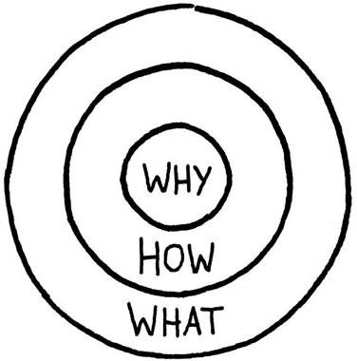
Why RSE and PD?
Builds Confidence and Competence – Academic Skill
Is truly inclusive – accessible to all irrespective of need / ability
Supports cognition and building of schema
Builds Character – Soft Skills needed for life
Natural end-point of learning
Cements the Learning Community
Students will be taught the consistent message and not hear it second hand from their peers

Slide 19
Q&A

