Slide 1
AQA GCSE Science
Why is science a core subject?
Studying science develops critical thinking skills needed for everyday life as well as enabling you to understand yourself and the world around.
These skills enable you to read and interpret information so that you make good decisions in many different areas of your life.
Having a science GCSE shows that you have developed these skills and opens many career paths for you.

Slide 2
AQA GCSE Science
Combined Science
Separate Biology, Chemistry and Physics
Less content to cover - 67% of the separate GCSE course
2 GCSE grades will be awarded
Grades are calculated on an average of biology, chemistry and physics
More content to cover
3 separate GCSE grades will be awarded
GCSE grades are completely independent
6 exams, 75 marks, 1 hr 15 minutes
6 exams, 100 marks, 1 hr 45 minutes

Slide 3
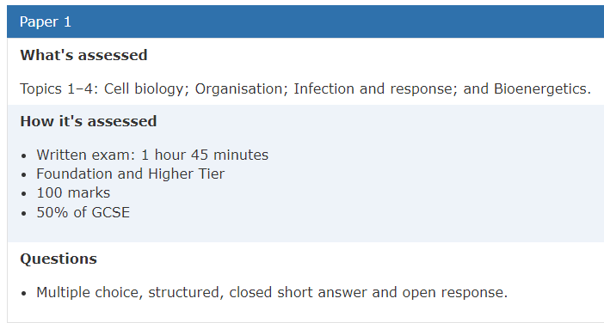
What can you do to prepare?
https://www.aqa.org.uk/subjects/science/gcse/combined-science-trilogy-8464/specification-at-a-glance
Know your exam board
Know your specification
Know what is in each exam
https://www.aqa.org.uk/subjects/science/gcse/biology-8461/specification-at-a-glance
https://www.aqa.org.uk/subjects/science/gcse/chemistry-8462/specification-at-a-glance
https://www.aqa.org.uk/subjects/science/gcse/physics-8463/specification-at-a-glance

Slide 4
What can you do to prepare?
Pay attention and take good notes in class.
Use your Class book and home learning booklets to complete regular retrieval practice.
Actively participate in lessons
Complete paper-based home learning activities.
Complete online home learning activities.
Start revising now if you haven’t already.
Use the summary contents table provided by your teachers to plan independent revision.

Slide 5
What can you do to prepare?
Use the specification to divide your revision over your available time, give extra time to more difficult topics.
Use a range of different revision materials so your don’t get bored.
Past papers AQA | Find past papers and mark schemes
Online platforms: Seneca learning, Quizlet, BBC bitesize, Primrose kitten quizzes, Primrose kitten videos, Physics and Maths tutor,
Revision guides and knowledge organiser booklets
Read/cover/repeat, retrieval mind maps, mnemonics, flash cards

Slide 6
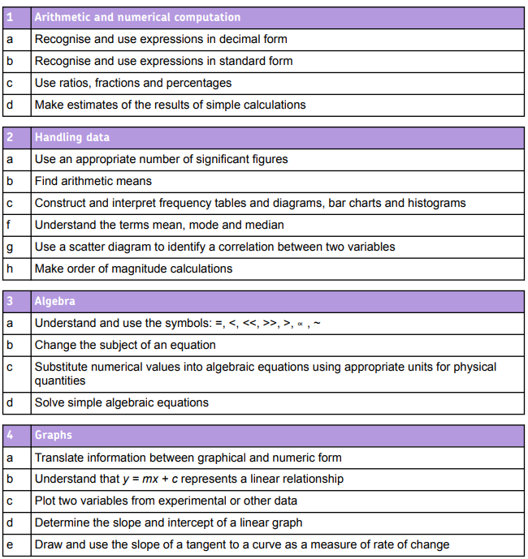
What can you do to prepare?
Know definitions for easy marks (retrieval practice).
Understand command words: List, name, describe, explain, evaluate, compare, use determine so you don’t miss out on marks by answering in the wrong way.
Practice answering long answer questions, so you are confident in the exam.
Know the required practicals inside out!
Practice the math skills required for the exams.
Page 171 of CS spec/ 75 of physics spec)

