Slide 1
Welcome to: Prepare to Perform 10th October 2023
Year 11 STUDY SUPPORT AND ADVICE EVENING for PARENTS, CARERS AND STUDENTS

Slide 2
The aims of this event:
To gain information from key subjects to support your child
To receive advice and guidance to help you to help your child to be successful in their studies in year 11, to include effective preparation for the forthcoming Pre-Public Exams (PPEs/Mocks)

Slide 3
Be in it to win it! Why every day of year 11 counts
The final sections of the course content is taught (often the most challenging aspects)
In some subjects, there are controlled assessments that cannot be repeated
Two PPE exam periods are crucial for teaching plans and closing knowledge and skills gaps
From January 2023 onwards retrieval and revise starts in full

Slide 4
What can you do as a parent/carer to enable your child to have a successful year 11
Ensure that your child attends school every day- CRUCIAL
Support with and check that homework is completed
At home, provide the best study environment/conditions that you can
Stay calm
Be a good listener
Reassure, encourage and praise
Be a study buddy
Set boundaries to manage study and free time
Ask the school for help and accept our honest feedback, advice and guidance

Slide 5
What can you do as a parent/carer to enable your child to have a successful year 11
Help your child to set goals
Ensure healthy eating
Monitor sleep
Support to unplug technology when studying

Slide 6
What we expect from year 11 students
Personal Standards​
Attendance​
Punctuality​
Behaviour​
Resolute attitude to Learning
Be your own person and find your inner drive
Progress​
Growth Mindset​
Hard work in lessons​
Hard work at home​
Revision​ in school and at home
Think about what else you need from us

Slide 7
There are no limits.
If you really want to do something, you’ll always find a way. If you don’t, you’ll always find an excuse

Slide 8
Effective Study

Slide 9
Wellbeing and mental health
Encourage them to build in opportunities to take some time out every week, away from study. For example:
Going out for food
Seeing friends
Having a bath
Listening to music
Reading a book
Doing a hobby
Going shopping
Going to the cinema

Slide 10
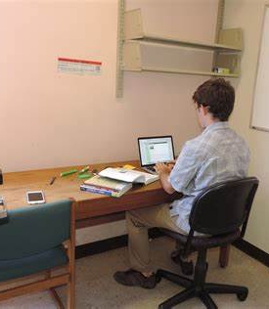
Find a quiet room to study in:
When it comes to study, anything that can divert your attention will. TV, Facebook, music, parents, brothers and sisters will all act as distractions. It is essential that you find a quiet place to study. If you can’t find a space like this at home think about a local library, school library, or friend’s place.

Slide 11
Sit up
Lying down tells your brain to go to sleep. Find a desk or table to work at.

Slide 12
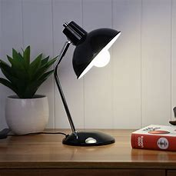
Light
Straining your eyes is both draining and secondly, distracting. Make sure the study space is well lit, preferably with a desk or table lamp as well.

Slide 13
Effective revision/study strategies:
tried and tested as successful

Slide 14
Effective and Proven Study Strategies for Success
Attend all additional study sessions
Revise/prepare in all subjects- not just English, Maths and Science
RAG rate existing knowledge and skills target revision
Self-quizzing using Knowledge Organisers.
Complete notes in weak areas and condense for each subject
Practise, practise, practise- exam style questions

Slide 15
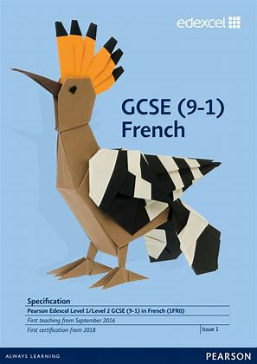
Subject Specifications Red Amber Green (RAG)
Target revision to the gaps/weaknesses

Slide 16
https://qualifications.pearson.com/en/qualifications/edexcel-gcses/mathematics
Measures and accuracy
What students need to learn:
N13 use standard units of mass, length, time, money and other measures
(including standard compound measures) using decimal quantities where
appropriate
N14 estimate answers; check calculations using approximation and estimation,including answers obtained using technology
N15 round numbers and measures to an appropriate degree of accuracy
(e.g. to a specified number of decimal places or significant figures); use
inequality notation to specify simple error intervals due to truncation or
rounding
N16 apply and interpret limits of accuracy

Slide 17
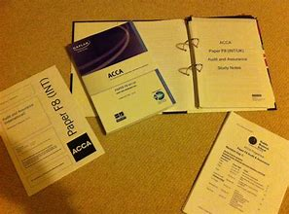
Strategy
Complete notes in weak areas: knowledge/skills for each subject in separate sections/note books or folders

Slide 18
Strategy
Organise notes- make condensed notes

Slide 19
Notes: Othello
Plot Overview
Othello begins on a street in Venice, in the midst of an argument between Roderigo, a rich man, and Iago. Roderigo has been paying Iago to help him in his suit to Desdemona. But Roderigo has just learned that Desdemona has married Othello, a general whom Iago begrudgingly serves as ensign. Iago says he hates Othello, who recently passed him over for the position of lieutenant in favor of the inexperienced soldier Michael Cassio.
Unseen, Iago and Roderigo cry out to Brabanzio that his daughter Desdemona has been stolen by and married to Othello, the Moor. Brabanzio finds that his daughter is indeed missing, and he gathers some officers to find Othello. Not wanting his hatred of Othello to be known, Iago leaves Roderigo and hurries back to Othello before Brabanzio sees him. At Othello’s lodgings, Cassio arrives with an urgent message from the duke: Othello’s help is needed in the matter of the imminent Turkish invasion of Cyprus. Not long afterward, Brabanzio arrives with Roderigo and others, and accuses Othello of stealing his daughter by witchcraft. When he finds out that Othello is on his way to speak with the duke, -Brabanzio decides to go along and accuse Othello before the assembled senate.
And these notes continue!

Slide 20
SMART NOTES:
CONDENSE THE LEARNING TO HEADINGS & BULLET POINTS

Slide 21
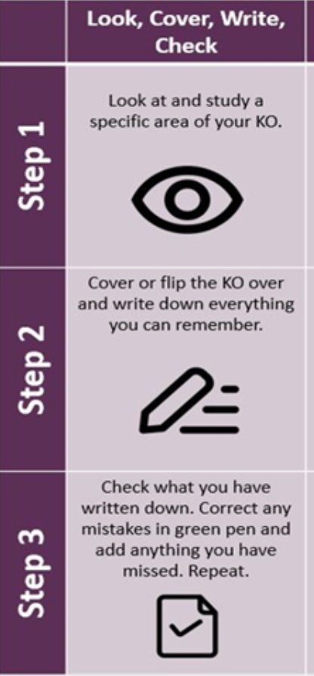
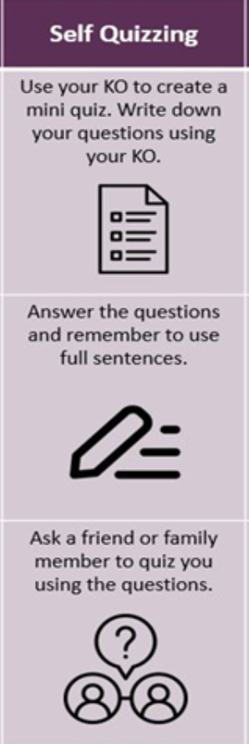
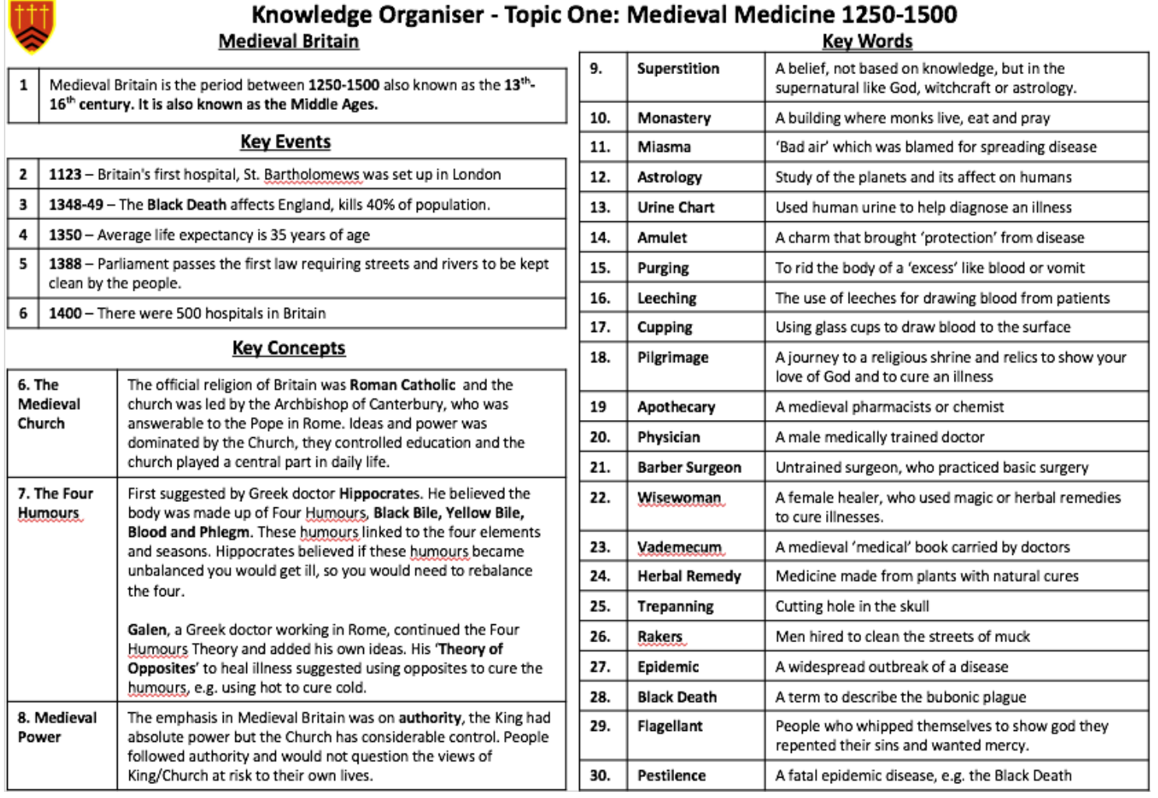
Strategy
Use of 'knowledge organisers'
'Look, Cover, Write, Check, Correct'
Self- Quizzing technique

Slide 22
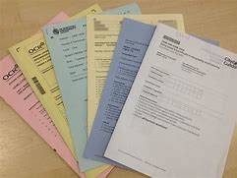
What is the most effective way to be prepared for exams? To practise, practise, practise
Exam practice questions and practicals to APPLY learning
with and without notes & condensed notes, untimed and timed.

Slide 23
Where you can access practice questions:
Teacher resources- given out
Internet: including exam boards, study websites, school subscriptions
Revision Guides, workbooks, class books

Slide 24
Students control the narrative of their GCSE journey

