Slide 1
Performing in the November PPE - Maths

Slide 2
How can students prepare
Making the most of lesson time
Completing homework
Attending lunchtime interventions
Attending after school intervention
Additional independent revision at home

Slide 3
Homework
Sparx
Exam questions
30 minutes per week of topics that will be on November PPE
Aim is to score 100% every week
Optional boost and target questions available every week
Upto ½ an exam paper per week
Model solutions are provided once completed
This homework is to develop student confidence with exam
technique

Slide 4
Interventions
Lunchtime
Afterschool
With your class teacher
Discuss homework, discuss tricky topics
Wednesday at 15:15 – 16:00
L1 with Mr Stanton in 109
R1 with Mr Yates in 119
L2, L3, R3 with Mrs Huskisson & Miss Gilbert in 106

Slide 5
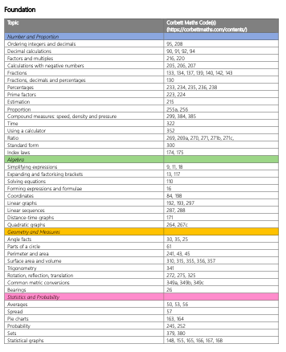
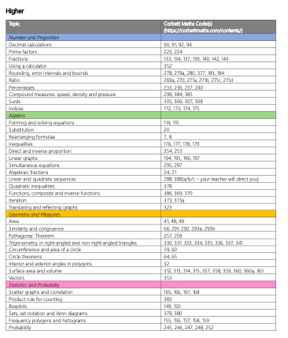
Independent revision: What is on the PPE?

Slide 6
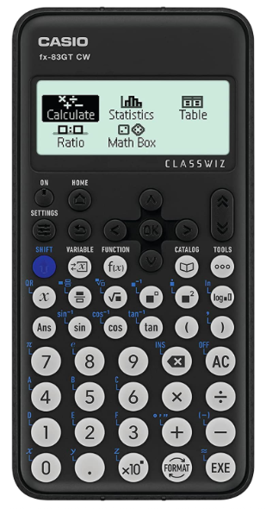
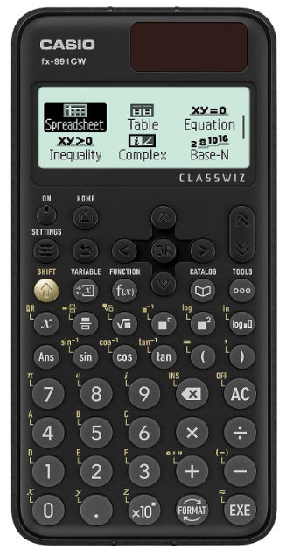
How can home help? - Calculators
$\frac{2}{3}$ of the final exam is on a calculator
$\frac{2}{3}$ of their written homework is on a calculator
The majority of their Sparx homework can be done on a calculator

