Slide 1
Succeeding in Mathematics

Slide 2
Why do we study Maths?
Gives students access to a significant body of knowledge
Pre-requisite for
6th form and university entrance
Opens up a range of career opportunities
A wide range of transferable skills are used in Maths
Skills for life such as Maths and money
Maths is amazing!

Slide 3
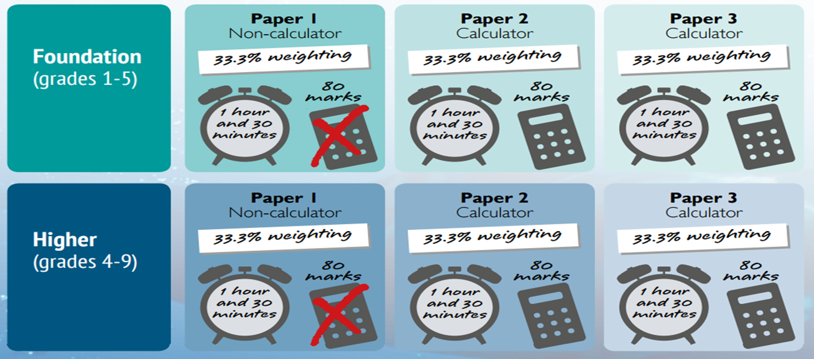

Slide 4
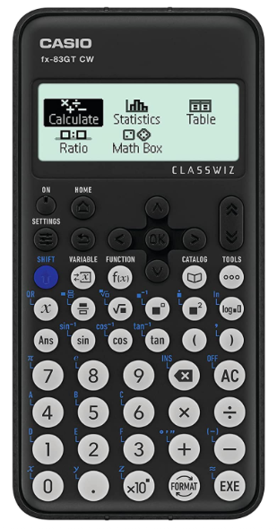
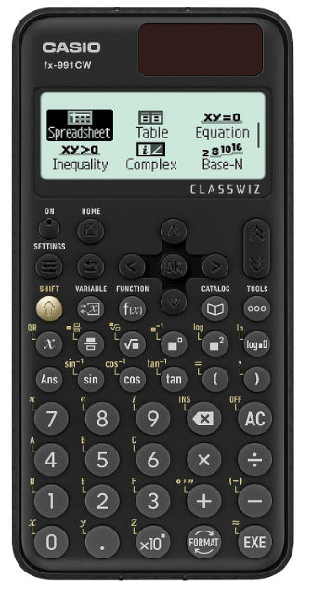
How can home help? - Calculators
$\frac{2}{3}$ of the final exam is on a calculator
$\frac{2}{3}$ of their written homework is on a calculator
The majority of their Sparx homework can be done on a calculator

Slide 5
How can home help – Sparx homework
Homework is set every Friday at 9am and due every Friday at 8am
The homework is set to a level suitable for the student
Sparx homework should take approximately 30 minutes
For it to be complete:
(i) Score of 100%
(ii) Got as many answers correct as possible, watched the video for
anything they don’t understand and tried the question again
(iii) Have a bespoke agreement as part of their school support

Slide 6
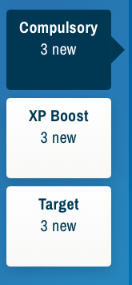
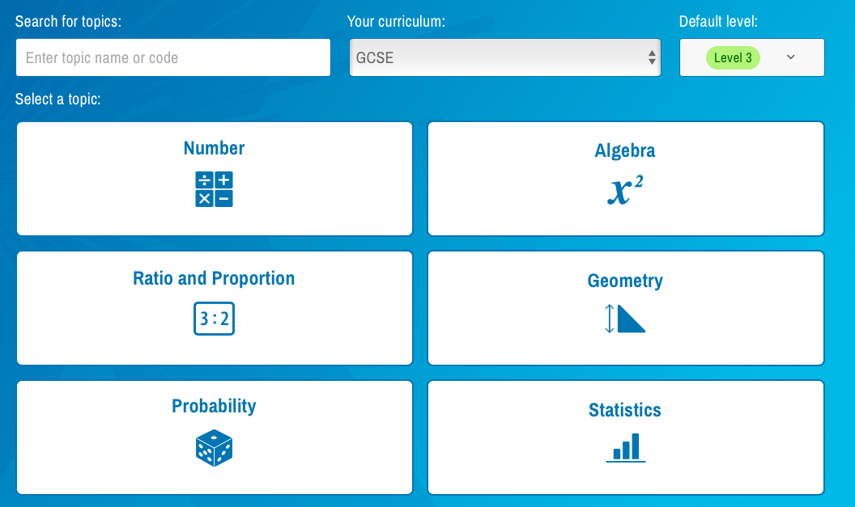
Sparx homework: Taking less than 30 minutes?

Slide 7
How can home help – exam question homework
Each week exam questions relevant to the current topic will be set by the class teacher, they have 1 week to complete them.
Students can take their books home to support them
Students can access Sparx Maths for support, watching a video based on this topic
Students can access other online platforms such as Corbett Maths or The GCSE Maths Tutor to find supporting videos.

Slide 8
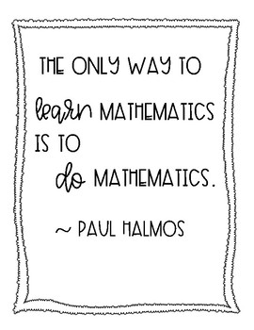
Taking responsibility for your learning
What should students be doing?
How can students help themselves?
Your exam
Your education
Your future

