Slide 1
YOU ARE AWESOME

Slide 2
LAST SESSION
Under pressure

Slide 3
TODAY’S SESSION
YOU WILL NEED

Slide 4
Read Chapter 8 of ‘You Are Awesome’.

Slide 5
What could have happened?
Bergen, Norway Germany

Slide 6
There can be some real ‘what on Earth am I going to do now?’ kind of moments. They’ll happen to you. They happen to everyone. Probably not in Bergen, Germany and probably not with Klaus and Jergen. But they’ll happen. So be ready. Be set to face anything difficult. And face it with a growth mindset (and ideally a fresh pair of pants).
How do you prepare for these moments?
page 149
Notes:
Page 138

Slide 7
Predicting the curve ball
Curve ball: to surprise someone with something that is difficult or unpleasant to deal with.
“Life throws you curve balls, but you either learn to swerve them or hit them like there is no tomorrow.”
Sadie Christman
How can you prepare yourself for life’s curve balls…
a) physically?
b) emotionally?

Slide 8
If
Rudyard Kipling, 1895
What examples of growth mindset can you find in each verse of this poem?
If you can keep your head when all about you
Are losing theirs and blaming it on you,
If you can trust yourself when all men doubt you,
But make allowance for their doubting too;
If you can wait and not be tired by waiting,
Or being lied about, don’t deal in lies,
Or being hated, don’t give way to hating,
And yet don’t look too good, nor talk too wise.
V1

Slide 9
If
Rudyard Kipling, 1895
What examples of growth mindset can you find in each verse of this poem?
If you can dream—and not make dreams your master;
If you can think—and not make thoughts your aim;
If you can meet with Triumph and Disaster
And treat those two impostors just the same;
If you can bear to hear the truth you’ve spoken
Twisted by knaves to make a trap for fools,
Or watch the things you gave your life to, broken,
And stoop and build ’em up with worn-out tools:
V2

Slide 10
If
Rudyard Kipling, 1895
What examples of growth mindset can you find in each verse of this poem?
If you can make one heap of all your winnings
And risk it on one turn of pitch-and-toss,
And lose, and start again at your beginnings
And never breathe a word about your loss;
If you can force your heart and nerve and sinew
To serve your turn long after they are gone,
And so hold on when there is nothing in you
Except the Will which says to them: ‘Hold on!’
V3

Slide 11
If
Rudyard Kipling, 1895
What examples of growth mindset can you find in each verse of this poem?
If you can talk with crowds and keep your virtue,
Or walk with Kings—nor lose the common touch,
If neither foes nor loving friends can hurt you,
If all men count with you, but none too much;
If you can fill the unforgiving minute
With sixty seconds’ worth of distance run,
Yours is the Earth and everything that’s in it,
And—which is more—you’ll be a Man, my son!
V4

Slide 12
At the beginning of the course you were asked to respond to each of these statements. Repeat this today, considering all you have learnt about growth mindset. How have your responses changed?

Slide 13
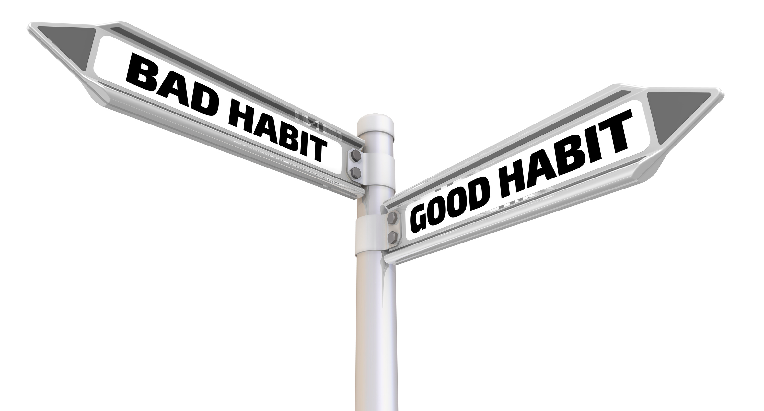
Growth mindset is a habit. It will become embedded and automatic the more your practise using it.
How will you ensure that you make this habit a permanent fixture in the way you approach challenging situations?

Slide 14
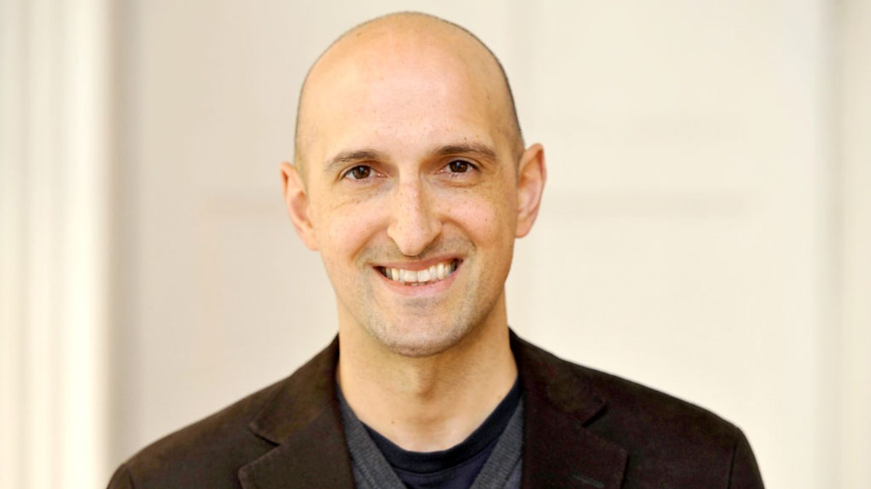
Matthew Syed

Slide 15
Your aspirations
Reflect on the aspirations you outlined at the beginning of the course. How will the changes in your mindset help you to work towards these? Which chapters of the book have had the most significant impact on the way you approach challenging situations? How will you use the other lessons on your journey towards awesome?

Slide 16
YOU ARE AWESOME

Slide 17
© Year 2018 The PiXL Club Ltd and Author Matthew Syed. All rights reserved.
If this resource has been provided under The PiXL Club Ltd school membership agreement, it is strictly for the use of member schools for as long as they remain members of The PiXL Club. It may not be copied, sold, or transferred to a third party or used by the school after membership ceases. Until such time it may be freely used within the member school.
The Author Matthew Syed has the right to sell this teaching guide. It may not be copied, sold, or transferred to or by a third party. Matthew Syed takes full responsibility for all commercial activity thereof.
All opinions and contributions are those of the author. The contents of this resource are not connected with, or endorsed by, any other company, organisation or institution. Any additional images are from getty.co.uk , unless otherwise stated. 'You Are Awesome' illustrations copyright © Toby Triumph.
Endeavours have been made to trace and contact copyright owners. If there are any inadvertent omissions or errors in the acknowledgements or usage, this is unintended and PiXL will be remedy these on written notification.

