Slide 1
YOU ARE AWESOME

Slide 2
LAST SESSION
Small steps and giant leaps

Slide 3
TODAY’S SESSION
YOU WILL NEED

Slide 4
Read Chapter 7 of ‘You Are Awesome’.

Slide 5
When it comes to a surprise collapse in performance, at a time when it matters most, ‘choking’ is a term often used to describe the experience. It may not leave you gasping for air, but it’s a deeply unpleasant thing for anyone to go through.
The first thing to note is that nervousness is natural. When faced with a threat, from a sporting opponent to an exam paper, our brain floods our body’s system with a naturally occurring hormone called Adrenaline.
Our heart beats faster, we breathe more quickly. Adrenaline is designed to prepare us for one of three physical responses. Either we take on the threat, or run away, or get frozen to the
spot. We call this a ‘fight, flight, freeze response’, and it’s
designed to help us survive. The trouble is, such a state of HIGH ALERT can also trigger a choke.
pages 138-139
Notes:
Page 138

Slide 6
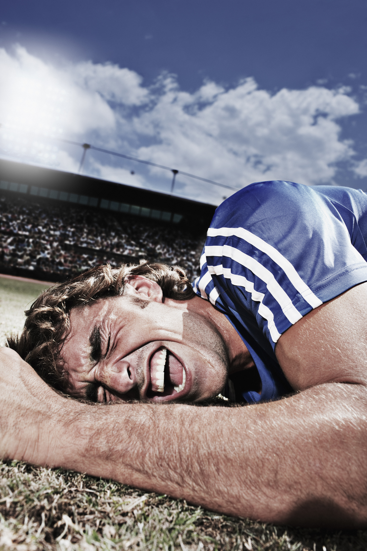
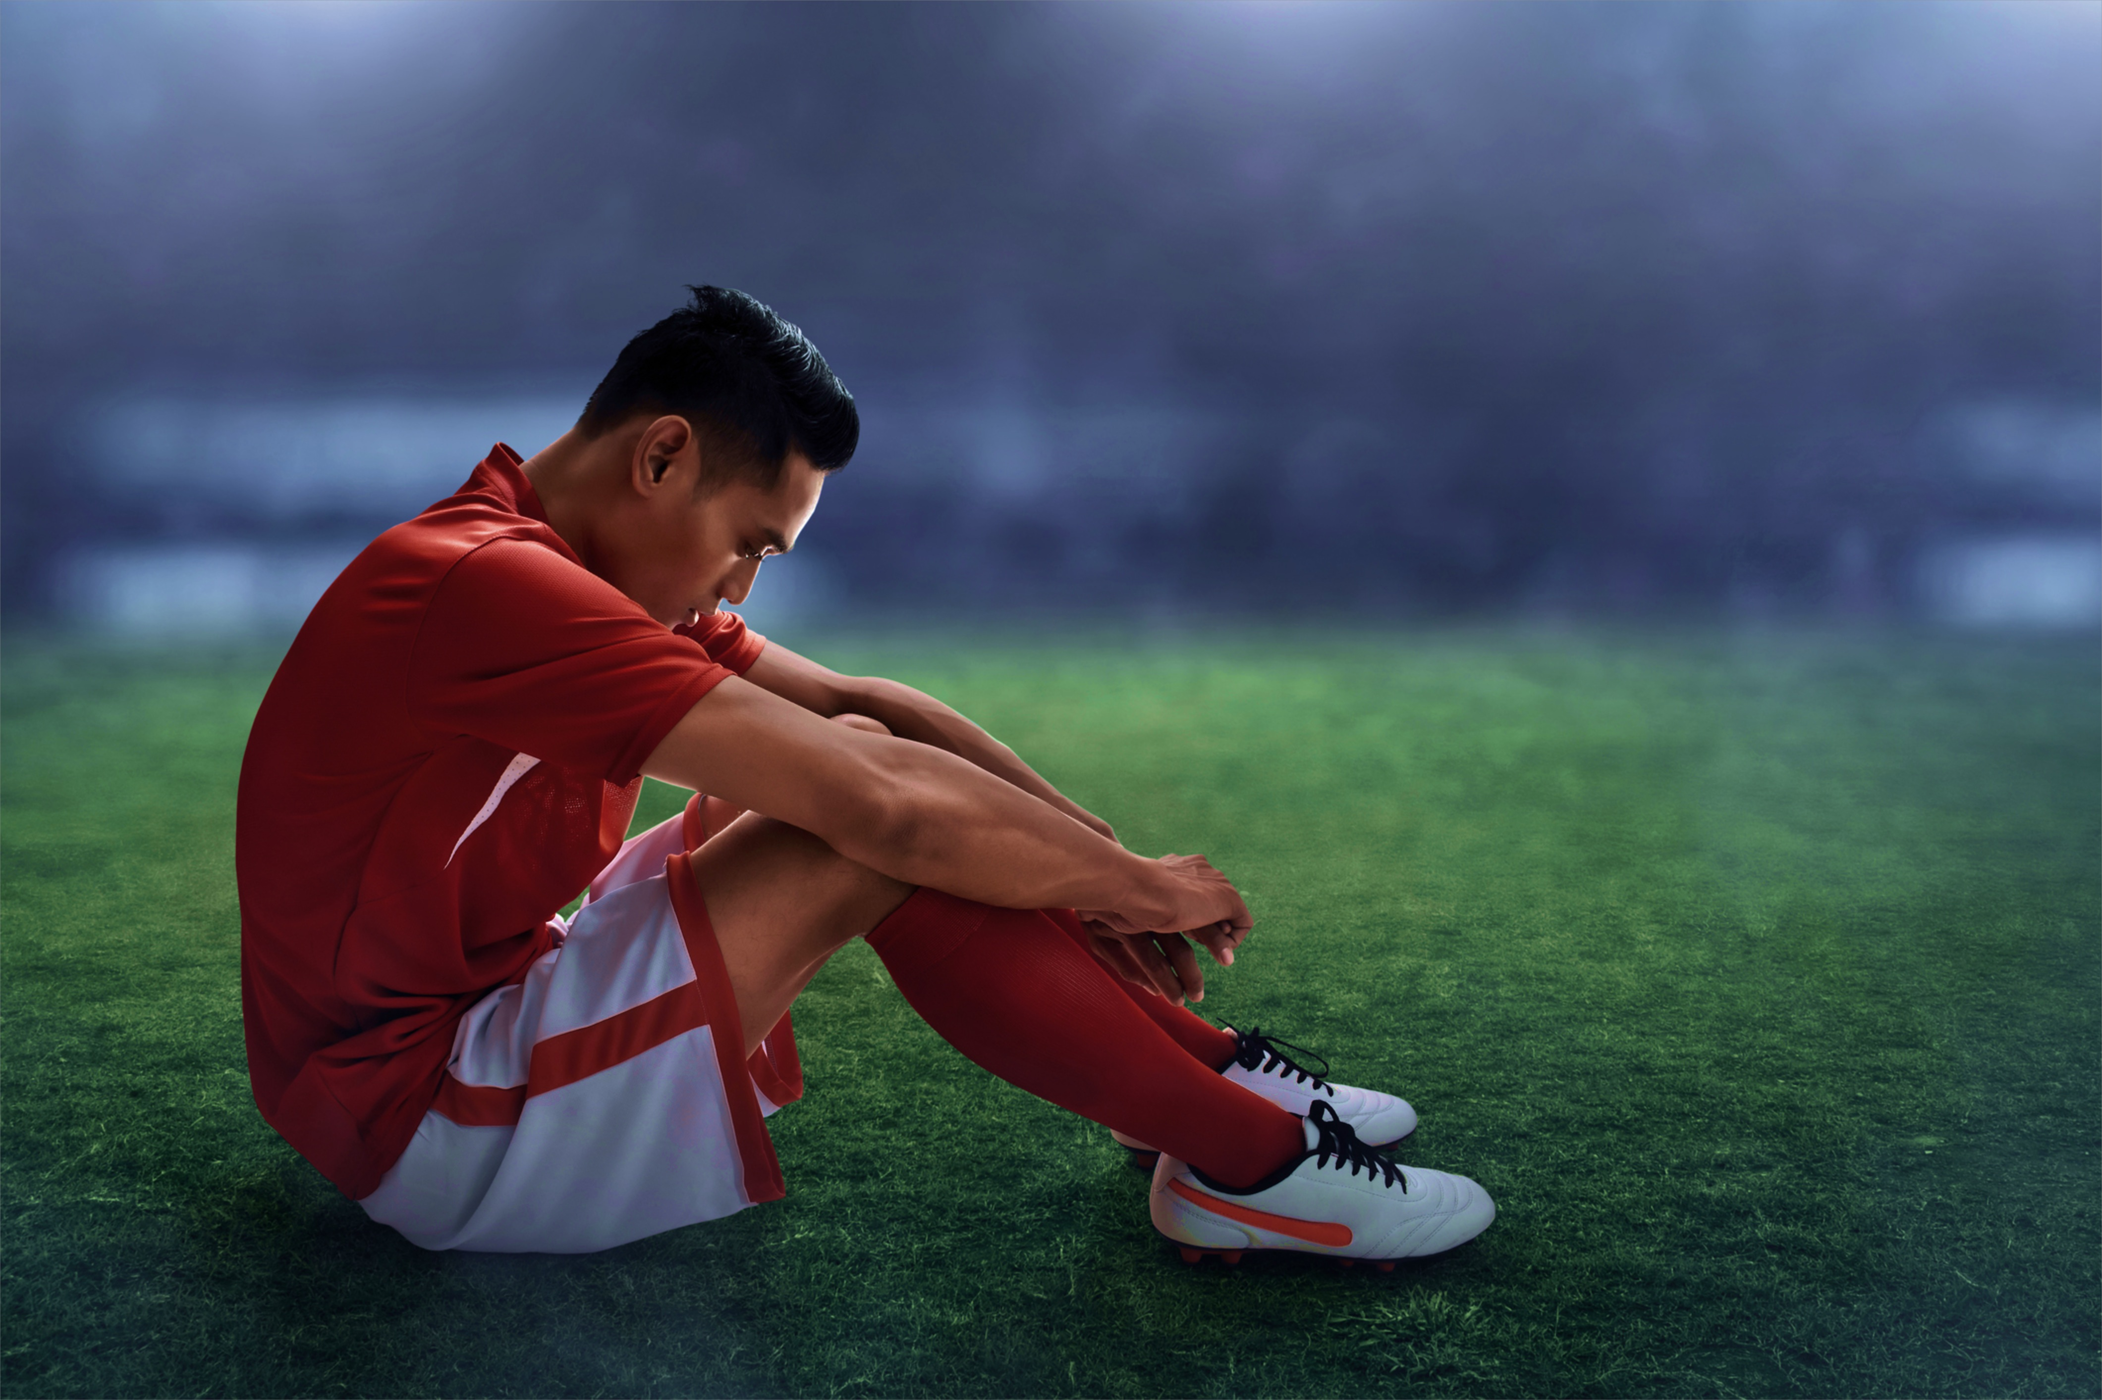
‘Choke’
Notes:
https://www.youtube.com/watch?v=gvd0uaTfX0w

Slide 7
What are the consequences of each of these responses to pressure? a) fight
b) flight
c) freeze
‘Choke’

Slide 8
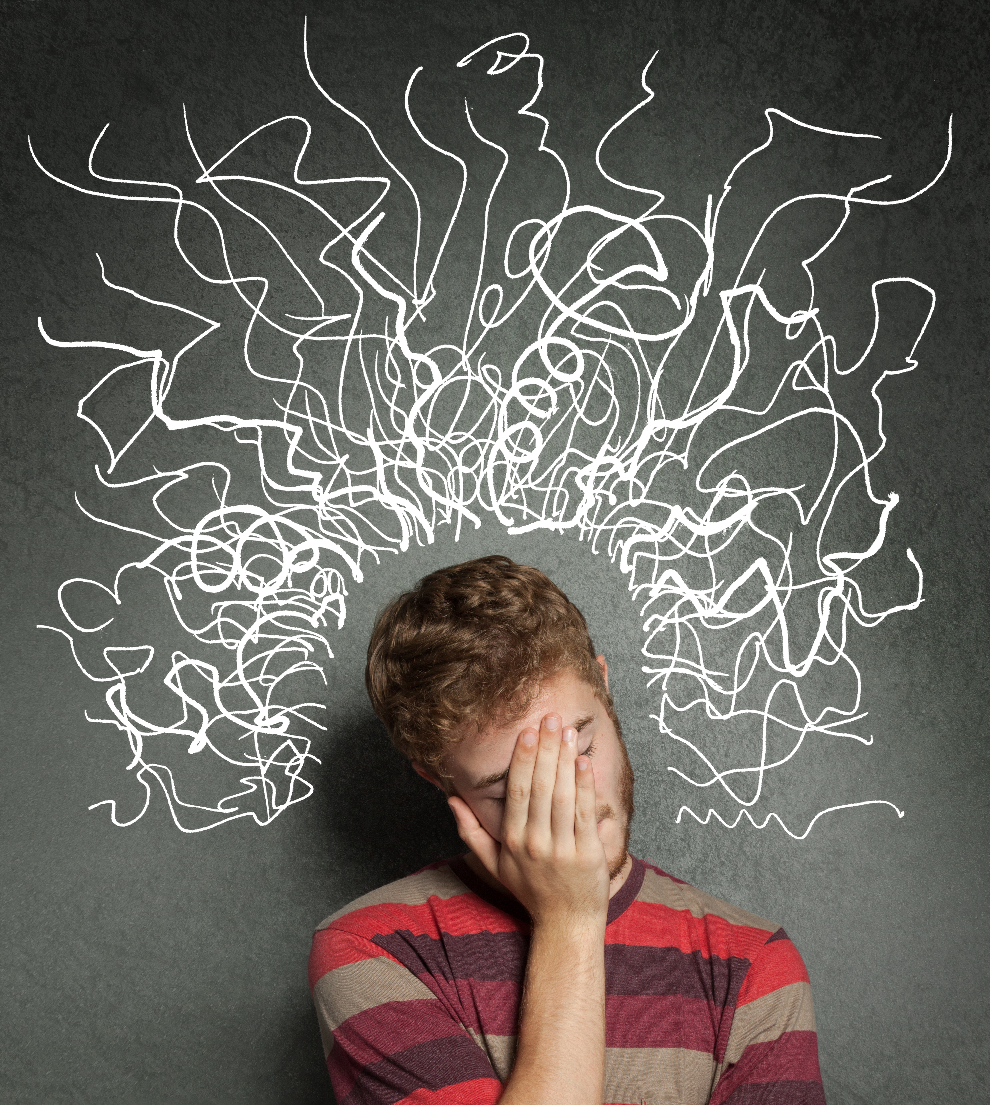
Think of a time when you have felt a lot of pressure to do something well. (e.g. exams, sport, music, school event, other)
a) Did it go well, or did you ‘choke’? b) Why? How did it make you feel?

Slide 9
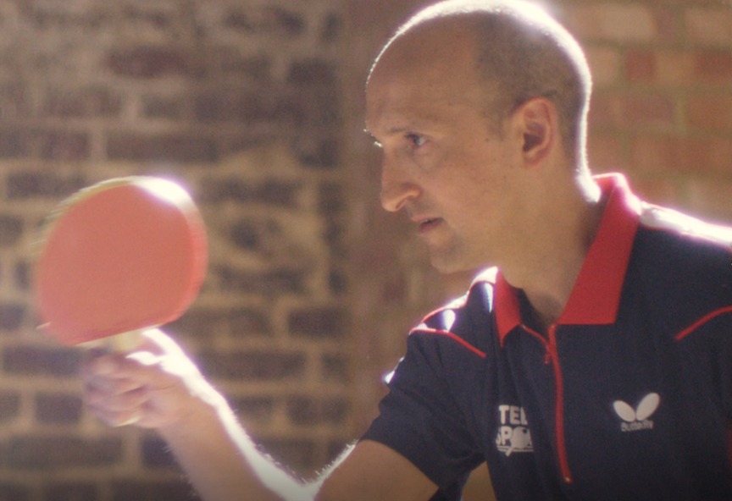
Can you remember… What were the 6 top tips to prevent ‘choking’?

Slide 10
Remember: nervousness is totally normal.
Focus on slow and deep breathing.
Don’t overthink it; zone out a bit.
Get things into perspective – life goes on!
Find routines & habits that keep you calm.
Performing under pressure is a skill – the more you perform under pressure, the better you’ll get.

Slide 11
CHALLENGE TIME
Complete the table by choosing an event that has happened or is soon to happen – that you might be worried about. What could go wrong, and how might you fix it?
EVENT: Playing the piano in a school assembly
Might go wrong | How to fix it
Might forget the music. | Set an alarm to remember to take music.
Might play a/some wrong notes. | Repeatedly tell yourself to ‘just keep playing’.
Might lose my place in the music. | Have a trusted friend nearby to turn the page.

Slide 12
What next?
Watch the video links and see how people with a range of different talents, skills and abilities can ‘choke’ in their field of knowledge.
List any possible factors that may have caused these people to ‘choke’ and suggest ways to prevent these taking place.
Notes:
http://www.bbc.co.uk/sport/13185266 – Rory Mcllroy
https://www.youtube.com/watch?v=f3tWqZ0pNC8 – John Terry missed penalty choke
http://www.nzherald.co.nz/sport/news/article.cfm?c_id=4&objectid=11422141
https://www.youtube.com/watch?v=dMMjyZubLaw – South Africa Cricket Team ‘Chokers’ tag
https://www.youtube.com/watch?v=E-mkm1vJY3c – USA Child Genius – spelling ‘choke’
https://www.youtube.com/watch?v=m9QDqAsAKUI - Star Spangled Banner ‘choke’

Slide 13
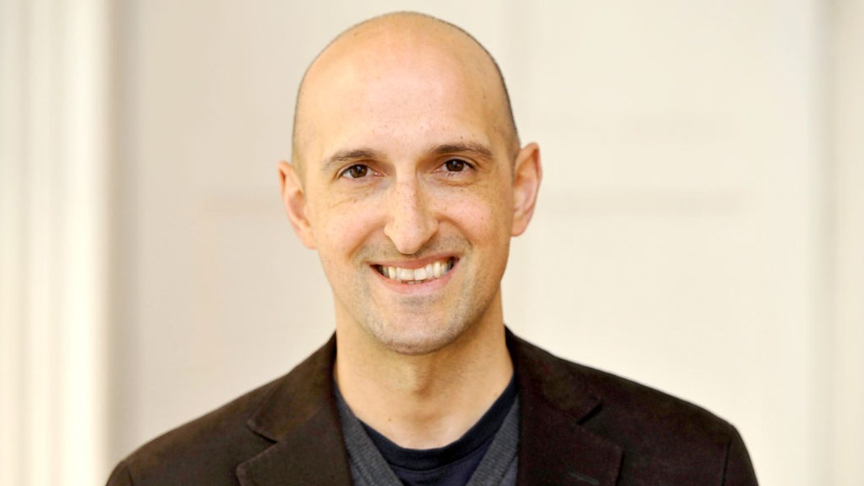
Matthew Syed

Slide 14
NEXT SESSION

Slide 15
YOU ARE AWESOME

Slide 16
© Year 2018 The PiXL Club Ltd and Author Matthew Syed. All rights reserved.
If this resource has been provided under The PiXL Club Ltd school membership agreement, it is strictly for the use of member schools for as long as they remain members of The PiXL Club. It may not be copied, sold, or transferred to a third party or used by the school after membership ceases. Until such time it may be freely used within the member school.
The Author Matthew Syed has the right to sell this teaching guide. It may not be copied, sold, or transferred to or by a third party. Matthew Syed takes full responsibility for all commercial activity thereof.
All opinions and contributions are those of the author. The contents of this resource are not connected with, or endorsed by, any other company, organisation or institution. Any additional images are from getty.co.uk , unless otherwise stated. 'You Are Awesome' illustrations copyright © Toby Triumph.
Endeavours have been made to trace and contact copyright owners. If there are any inadvertent omissions or errors in the acknowledgements or usage, this is unintended and PiXL will be remedy these on written notification.

