Slide 1
YOU ARE AWESOME

Slide 2
LAST SESSION
Genius or what?

Slide 3
TODAY’S SESSION
YOU WILL NEED

Slide 4
Read Chapter 6 of ‘You Are Awesome’.

Slide 5
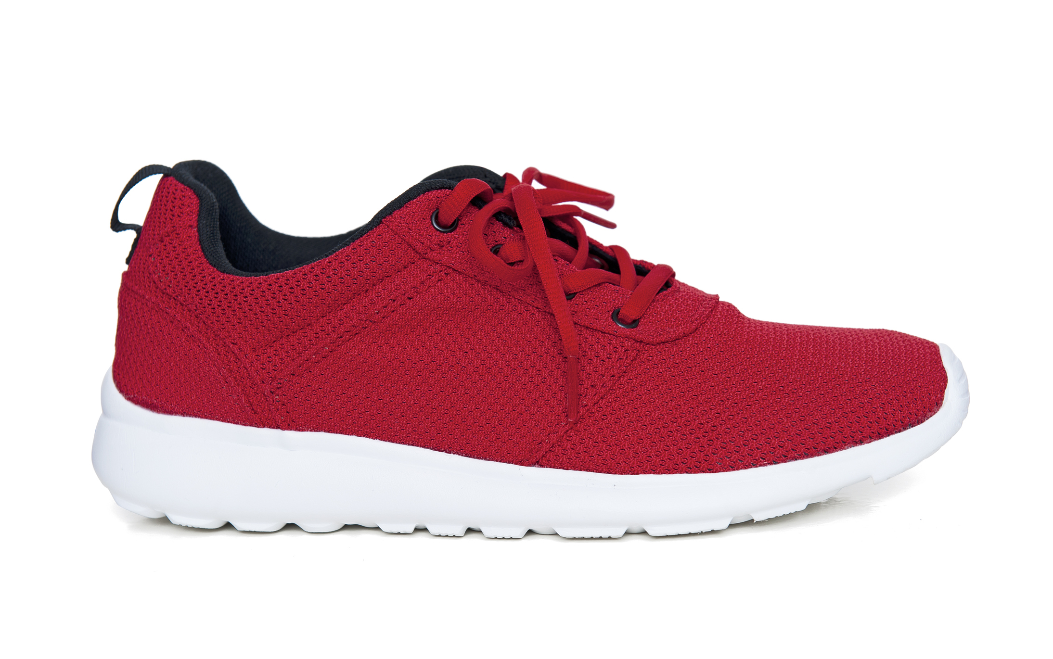
Marginal Matthew
What did Marginal Matthew change to help him achieve his goal?

Slide 6
With all the components laid out in front of me, I was able to look at each one in turn. It made it easier to figure out what was going to help me to achieve the goal of beating my brother. I wrote down what needed to change if I was going to win. I also made a point of highlighting what worked.
Why do you think this approach worked for Matthew? What do you think are the key words/phrases in this explanation?
page 128
Notes:
Page 138

Slide 7
Have you got experience of this being true?
Is it easier to improve when you’re working on your own or as part of a team? Why do you think that?
Notes:
The following image is free to share and use commercially:
https://www.bing.com/images/search?view=detailV2&ccid=%2b6D3OC8l&id=AFF4A090F60B8F645040F07371207BA5F9835AEC&thid=OIP.-6D3OC8lFTn0Cq3zNIPNIAHaGN&mediaurl=http%3a%2f%2fwww.betergezond.be%2fwp-content%2fuploads%2f2017%2f05%2fPeppertalk-Big-journeys-begin-with-small-steps..jpg&exph=788&expw=940&q=big+journeys+begin+with+small+steps&simid=608049908292846963&selectedIndex=3&qft=+filterui%3alicense-L2_L3_L4&ajaxhist=0

Slide 8
CHALLENGE TIME
How quickly can you recite the alphabet backwards?
What 3 small changes could you make to help you improve next time?
1.
2.
3.
Try again. How quickly can you do it now?

Slide 9
Implementing the theory
CURRENT POSITION
ASPIRATION
ACTIONS

Slide 10
My Marginal Gains Plan
My goal:
The current picture | What I’ll change

Slide 11
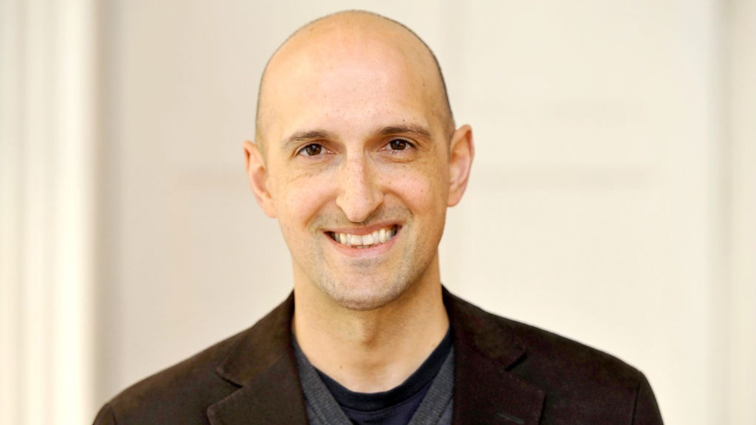
Matthew Syed

Slide 12
What next? Research and explore
Identify someone outside of sport who has achieved success in their field.
Research their journey to success and identify three small things that they changed that improved their performance.

Slide 13
NEXT SESSION

Slide 14
YOU ARE AWESOME

Slide 15
© Year 2018 The PiXL Club Ltd and Author Matthew Syed. All rights reserved.
If this resource has been provided under The PiXL Club Ltd school membership agreement, it is strictly for the use of member schools for as long as they remain members of The PiXL Club. It may not be copied, sold, or transferred to a third party or used by the school after membership ceases. Until such time it may be freely used within the member school.
The Author Matthew Syed has the right to sell this teaching guide. It may not be copied, sold, or transferred to or by a third party. Matthew Syed takes full responsibility for all commercial activity thereof.
All opinions and contributions are those of the author. The contents of this resource are not connected with, or endorsed by, any other company, organisation or institution. Any additional images are from getty.co.uk , unless otherwise stated. 'You Are Awesome' illustrations copyright © Toby Triumph.
Endeavours have been made to trace and contact copyright owners. If there are any inadvertent omissions or errors in the acknowledgements or usage, this is unintended and PiXL will be remedy these on written notification.

