Slide 1
YOU ARE AWESOME

Slide 2
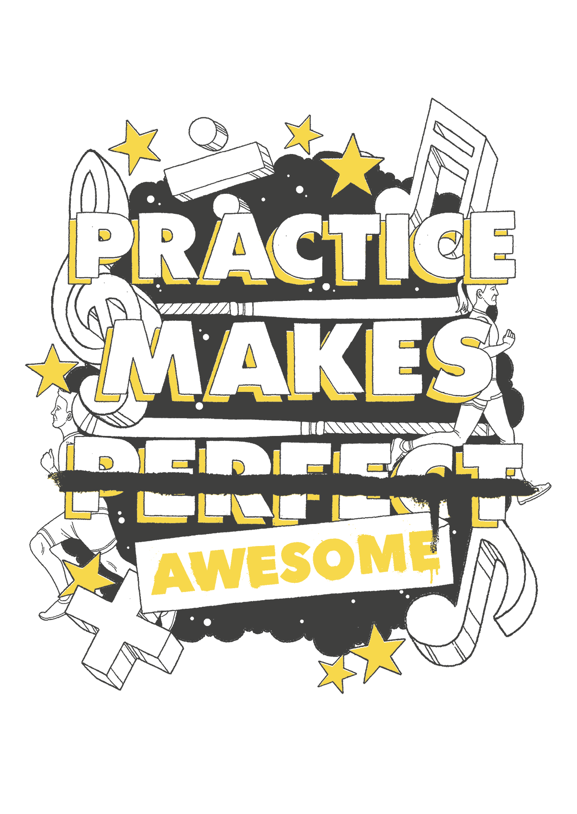
LAST SESSION
Practice makes perfect awesome

Slide 3
TODAY’S SESSION
YOU WILL NEED

Slide 4
Read Chapter 5 of ‘You Are Awesome’.

Slide 5
Nobody hits a perfect note on the first attempt at singing, or finds they can effortlessly weave a football straightaway. It’s a question of learning from experience and recognising that any learning experience involves making plenty of mistakes.
When we witness someone performing at a high level, it doesn’t make for very good viewing if the pianist we paid to see can’t remember the notes, or the racing driver repeatedly stalls the car. As a result, when it comes to success we don’t often see the whole story, from the hours that have
gone into that amazing performance to the times they have landed face-first or hit the wrong notes.
page 96
Notes:
Page 138

Slide 6
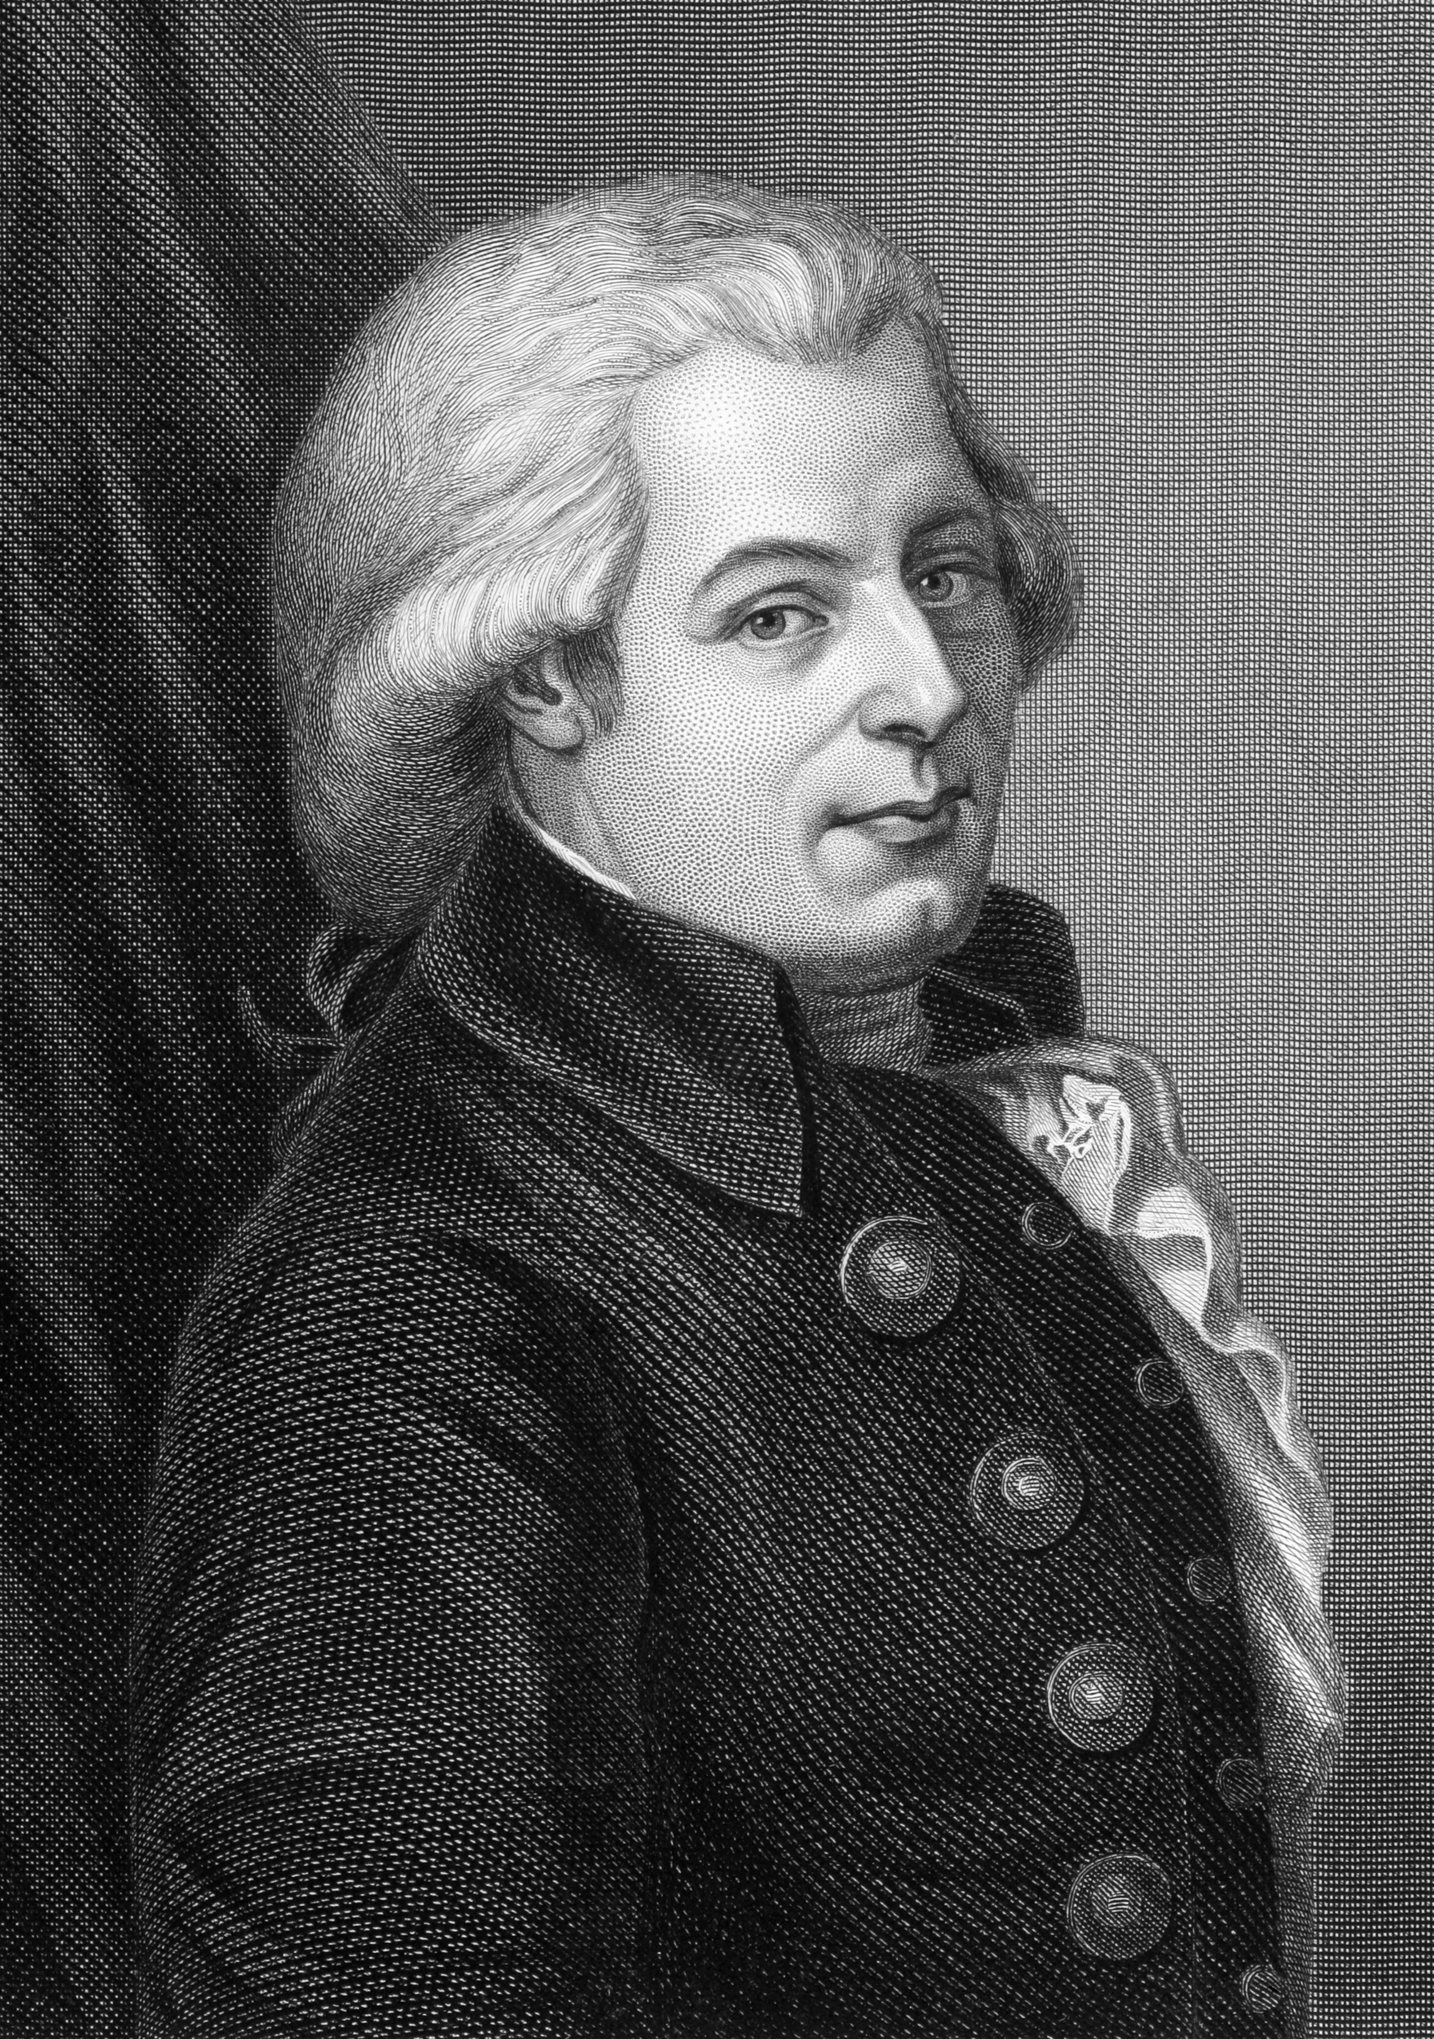
began piano at age of 3
“I too had to work hard, so as not to have to work hard any longer.”
Wolfgang Amadeus Mozart
had a very pushy father
Listen to Mozart
Factors of Success
Notes:
https://www.youtube.com/watch?v=EFcyo_WMF7o

Slide 7
Watch Serena Williams play
committed father – started at 3
hours and hours
stamina on poor courts
Factors of Success
Notes:
https://www.youtube.com/watch?v=vOddugWjNVs

Slide 8
Human Calculator – Indian mathematician
Shakuntala Devi
7,686,369,774,870
X 2,465,099,745,779
= 18,947,668,177,995,426, 773, 730
Time taken?
28 seconds!

Slide 9
CHALLENGE TIME
32 x 14

Slide 10
CHALLENGE TIME
32 x 14
STEP 1:
32 x 10
= 320

Slide 11
CHALLENGE TIME
32 x 14
STEP 2:
30 x 4
= 120

Slide 12
CHALLENGE TIME
32 x 14
STEP 3:
Add together our totals so far (320+120)

Slide 13
CHALLENGE TIME
32 x 14
STEP 4:
2 x 4
= 8

Slide 14
CHALLENGE TIME
32 x 14
STEP 5:
Add 440 + 8
= 448

Slide 15
Do you agree with this comment?
Why or why not?
“It is not always people who start out the smartest who end up the smartest.”
Carol Dweck, Mindset

Slide 16
Do you agree with this comment?
…
Why or why not?
“Life is like a canvas. It begins blank, and every day is like another brush stroke. Make life your masterpiece.”
- Life
boardofwisdom.com

Slide 17
What next?
Think: Think of somebody who is excellent at what they do (a sportsperson, a singer, an author, a dancer, a musician, a chef, a magician).
Explore: Research their childhood and their experience. What led them to be so good at what they do? How often do they practise? What training did they have? Who helped them?

Slide 18
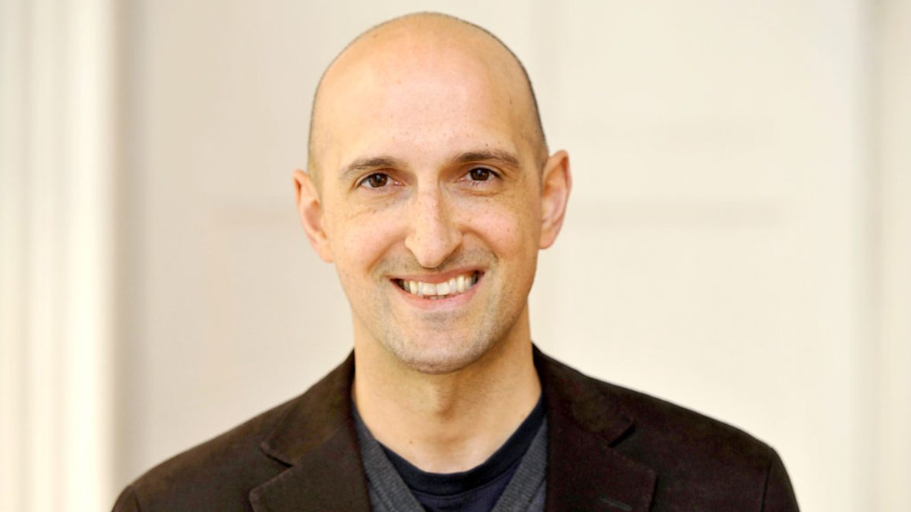
Matthew Syed

Slide 19
NEXT SESSION

Slide 20
YOU ARE AWESOME

Slide 21
© Year 2018 The PiXL Club Ltd and Author Matthew Syed. All rights reserved.
If this resource has been provided under The PiXL Club Ltd school membership agreement, it is strictly for the use of member schools for as long as they remain members of The PiXL Club. It may not be copied, sold, or transferred to a third party or used by the school after membership ceases. Until such time it may be freely used within the member school.
The Author Matthew Syed has the right to sell this teaching guide. It may not be copied, sold, or transferred to or by a third party. Matthew Syed takes full responsibility for all commercial activity thereof.
All opinions and contributions are those of the author. The contents of this resource are not connected with, or endorsed by, any other company, organisation or institution. Any additional images are from getty.co.uk , unless otherwise stated. 'You Are Awesome' illustrations copyright © Toby Triumph.
Endeavours have been made to trace and contact copyright owners. If there are any inadvertent omissions or errors in the acknowledgements or usage, this is unintended and PiXL will be remedy these on written notification.

