Slide 1
YOU ARE AWESOME

Slide 2
How did you respond to the following statements in your self-assessment?
2. You cannot change your level of intelligence very much by learning.
11. The harder you work at something, the better you will get.
How could these statements either motivate or demotivate you?

Slide 3
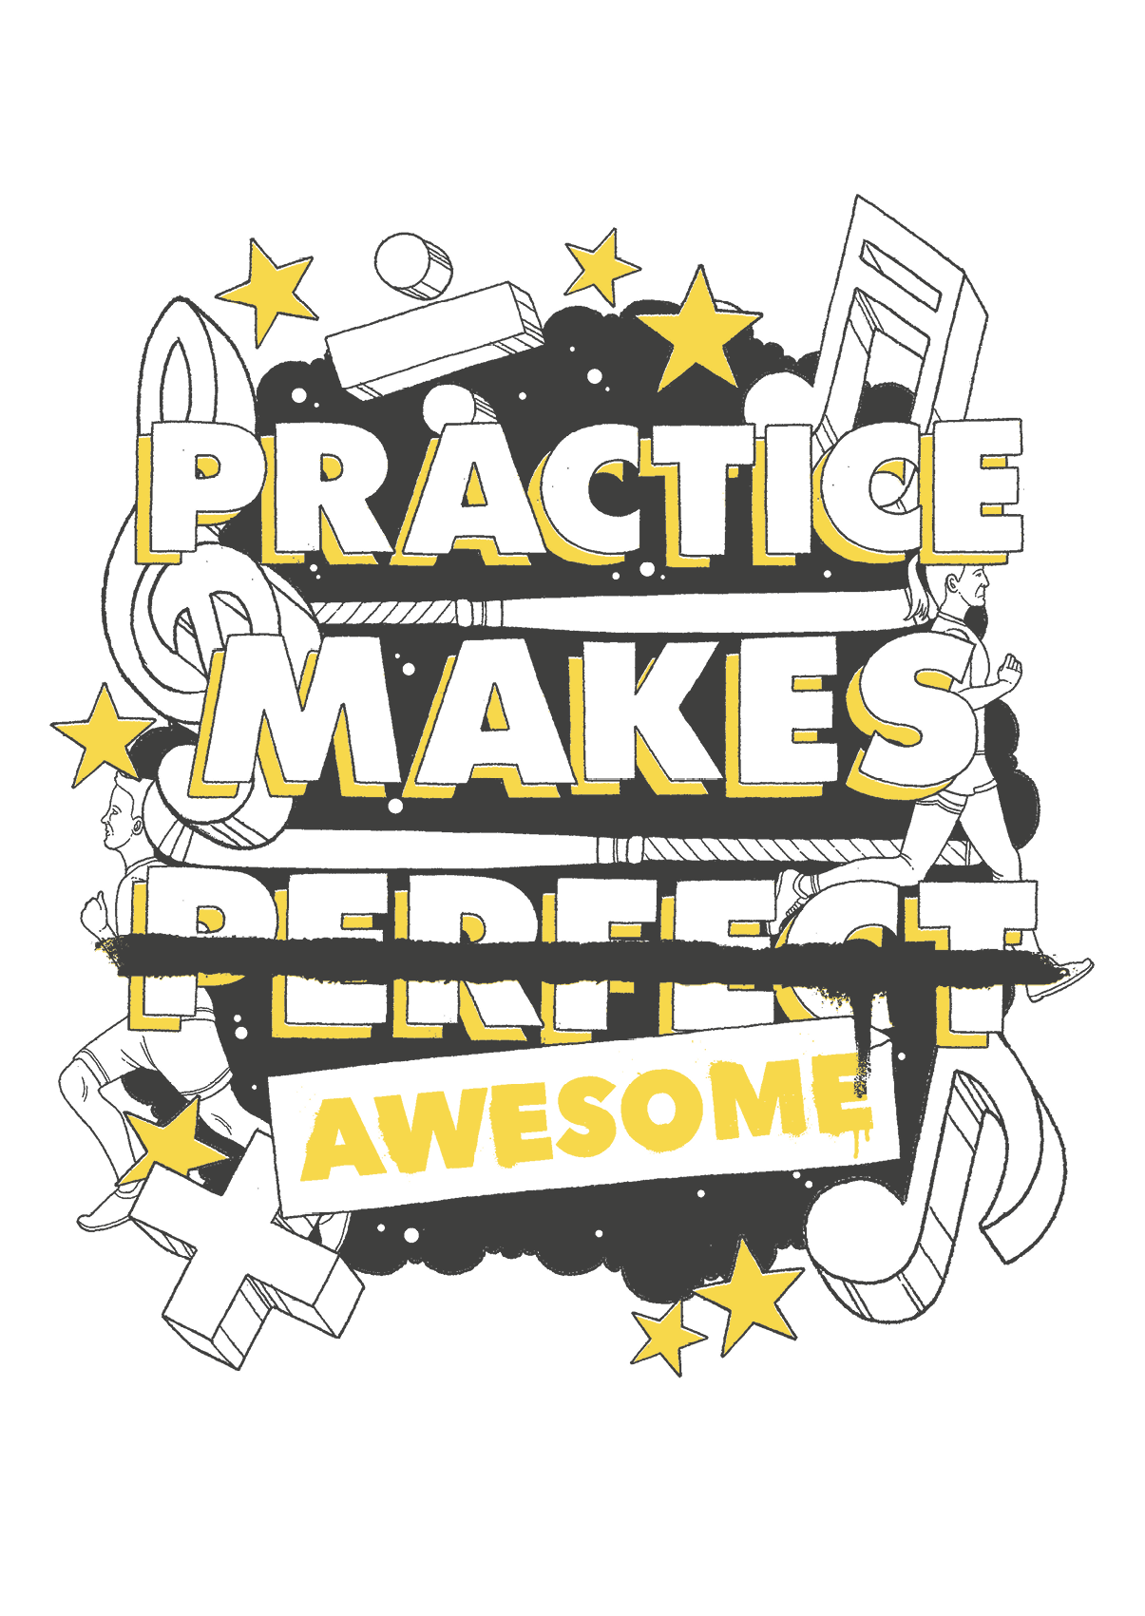
TODAY’S SESSION
YOU WILL NEED

Slide 4
Read Chapter 4 of ‘You Are Awesome’.

Slide 5
The practice that really works, that builds those strong and lasting neural connections is practice that challenges you. The Hard Stuff. The stuff that might make your eyes water, your muscles ache or your brain hurt. The screw-your-face-up, grit-your-teeth kind of practice that makes you feel good about yourself afterwards because you know you’ve achieved something.
Can you think of a time when you have practised like this? What were you practising and why?
pages 82-83
Notes:
Page 138

Slide 6
Practising effectively: 5 top tips
1
Practise with people who are better than you.
2 Present in front of other people.
3 Choose the challenging tasks, not the easy ones.
4 Speak aloud and embrace your mistakes.
5 Practise in the conditions you will need to perform in.
How can you motivate yourself to practise like this?

Slide 7
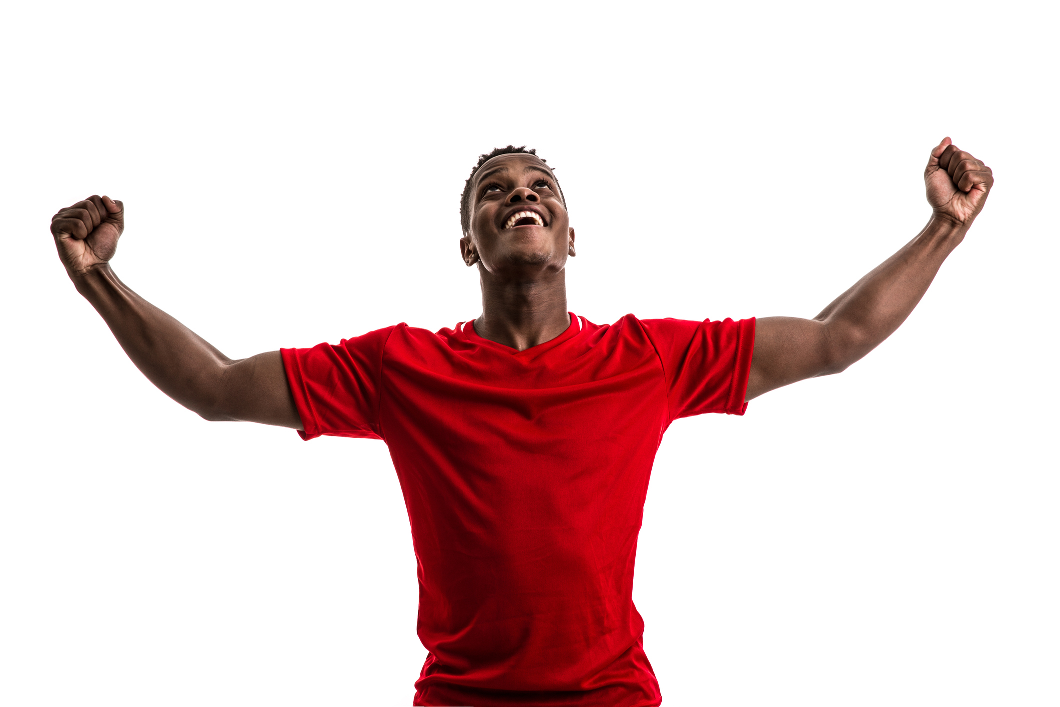
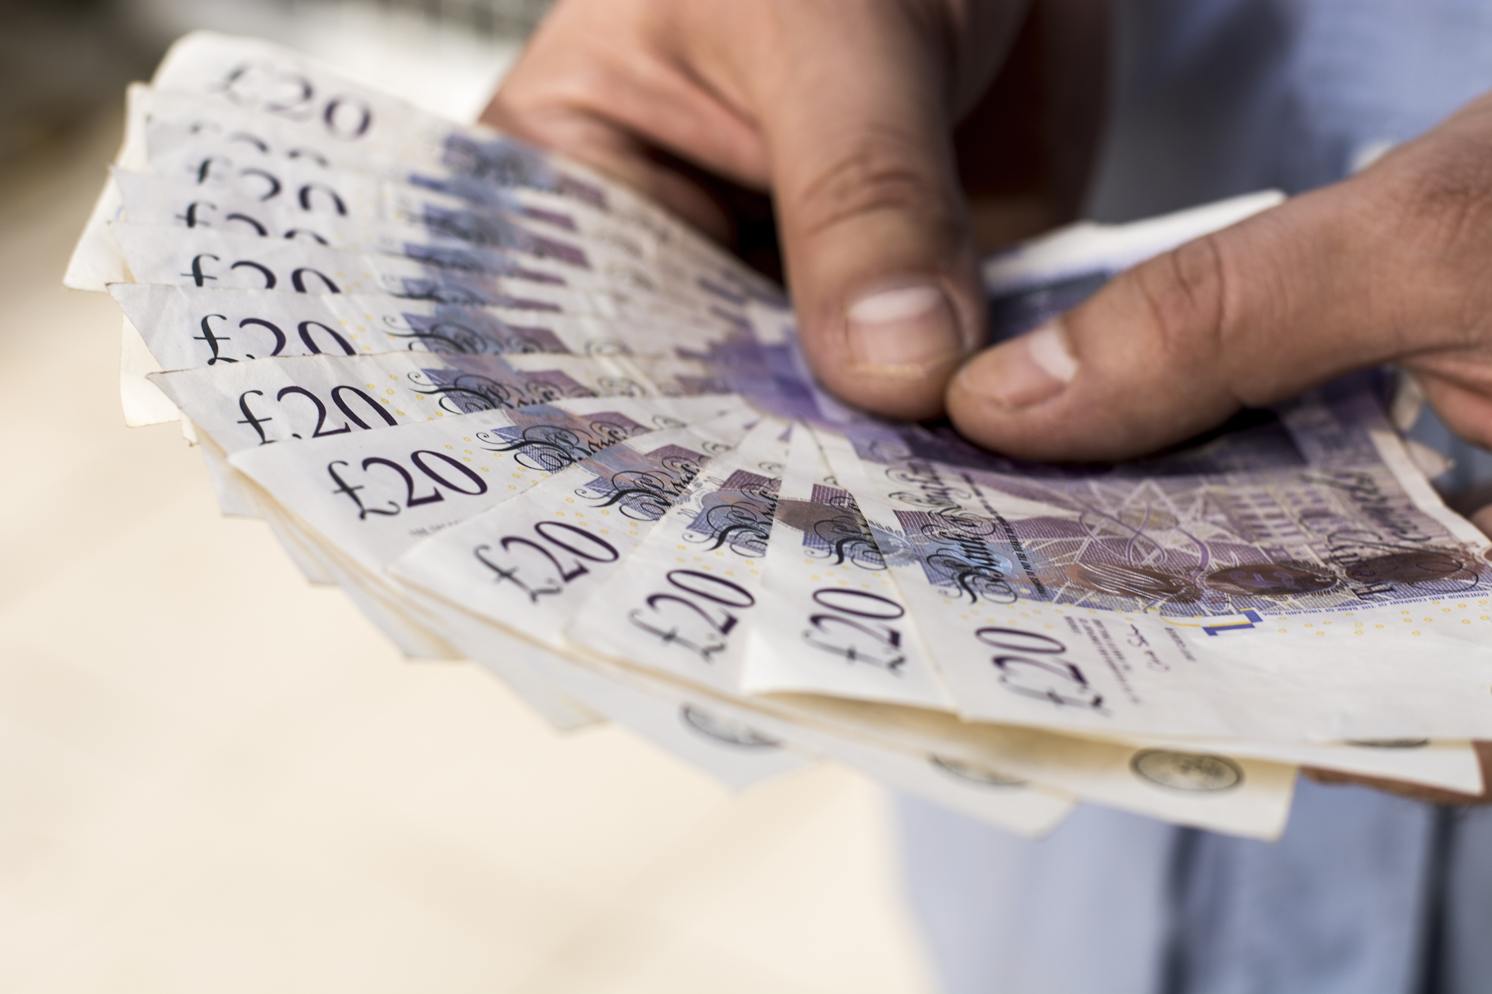
The end goal
Imagining the end goal can help you to challenge yourself.
What motivates you to practise hard?

Slide 8
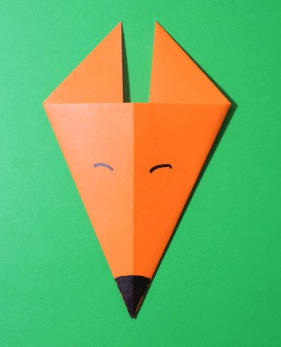
Benjamin Franklin:
‘I didn’t fail the test. I just found 100 ways to do it wrong.’
Have a go at making this origami fox’s face from your paper.
Be like Benjamin – find some ways to get it wrong!

Slide 9
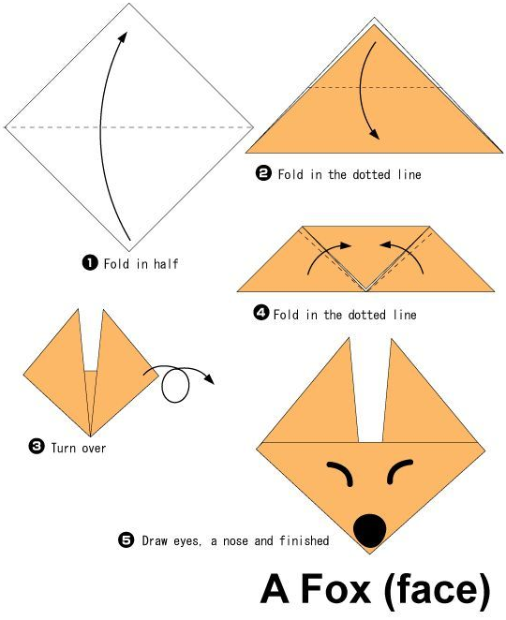
The solution
1. How does yours compare?
2. Did you work it out on your own or need to follow the instructions?
3. Where/how could you make improvements?

Slide 10
Making friends with feedback
What makes good feedback?
How can you manage your emotional response to feedback?

Slide 11
Responding to feedback
How can a growth mindset approach help you to make the most of feedback?
What Kid Average might say when they were told how they could improve | What Kid Awesome might say when they were told how they could improve

Slide 12
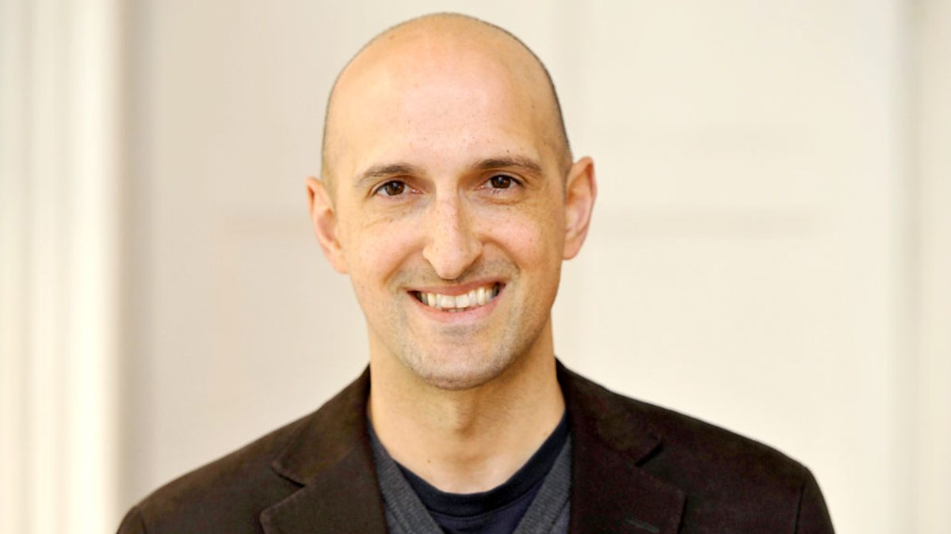
Matthew Syed

Slide 13
What next? Seeking out feedback
Identify something that you want to improve at this week.
Write down how you will seek high-quality feedback that will help you to improve.
Once you have acted on it, reflect on the impact of this feedback on your journey towards your goal.

Slide 14
NEXT SESSION

Slide 15
YOU ARE AWESOME

Slide 16
© Year 2018 The PiXL Club Ltd and Author Matthew Syed. All rights reserved.
If this resource has been provided under The PiXL Club Ltd school membership agreement, it is strictly for the use of member schools for as long as they remain members of The PiXL Club. It may not be copied, sold, or transferred to a third party or used by the school after membership ceases. Until such time it may be freely used within the member school.
The Author Matthew Syed has the right to sell this teaching guide. It may not be copied, sold, or transferred to or by a third party. Matthew Syed takes full responsibility for all commercial activity thereof.
All opinions and contributions are those of the author. The contents of this resource are not connected with, or endorsed by, any other company, organisation or institution. Any additional images are from getty.co.uk , unless otherwise stated. 'You Are Awesome' illustrations copyright © Toby Triumph.
Endeavours have been made to trace and contact copyright owners. If there are any inadvertent omissions or errors in the acknowledgements or usage, this is unintended and PiXL will be remedy these on written notification.

