Slide 1
YOU ARE AWESOME

Slide 2
Have your responses to any of these statements changed? How? Why?

Slide 3
TODAY’S SESSION
YOU WILL NEED

Slide 4
Read Chapter 2 of ‘You Are Awesome’.

Slide 5
The world around us is changing so fast. It’s no wonder that we sometimes feel anxious about how we fit into it. We question whether we are smart enough. We get a bit scared to have a go (in case we look stupid). And sometimes it’s tempting to quit before we’ve even tried something. Lots of anxieties and worries can hold us back. So let’s take a look and see how we can overcome them. Because it’s good to be READY. PREPPED. CONFIDENT. On fire! We need to find our confidence to deal with all the changes and challenges that life can bring.
page 33
Notes:
Page 138

Slide 6
Discuss
Matthew came up against these obstacles on his path to success. 1. Which would be the most likely to stop you from even attempting something challenging?
2. How are they all linked?
Fear of looking foolish.
Everyone is way better than me.
Hard work is a bit of a hassle.
Confidence crises.
Who even am I?

Slide 7
Different kinds of obstacles
Obstacle (noun): something that blocks your way or prevents progress
Think about a time when your school day or other activity has not gone well and you’ve been unable to achieve what you wanted to. Why was this? What obstacles got in your way?
Obstacles within my control:
Obstacles outside of my control:

Slide 8
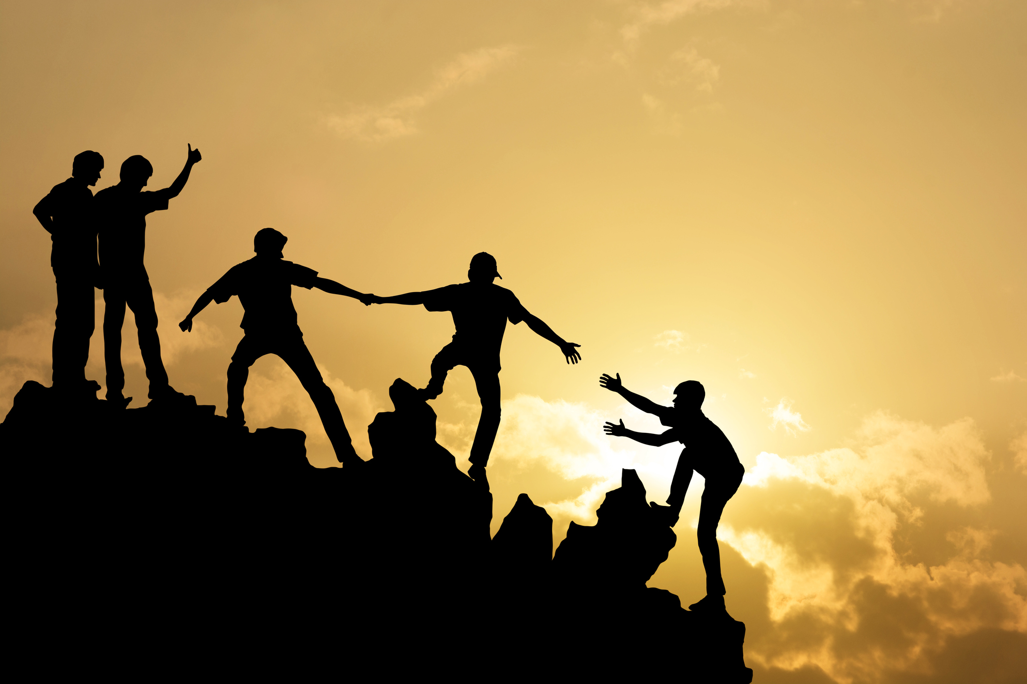
Pre-empting the obstacles
During session 1 you wrote down some lifetime goals. Focus on one of these. Consider the obstacles that you might face on the way to achieving this goal.
Which of these are within or out of your control? Which are driven by emotional responses to challenge?
How could you plan to get around each of these? What or who could help you?

Slide 9
Different solutions to the same problem
You leave your PE kit on the bus on the day of an important sports match.
1.
2.
3.
4.
Fixed mindset: I won’t bother playing in the match then.
Growth mindset: How can I get around this obstacle so that I can still play the match?

Slide 10
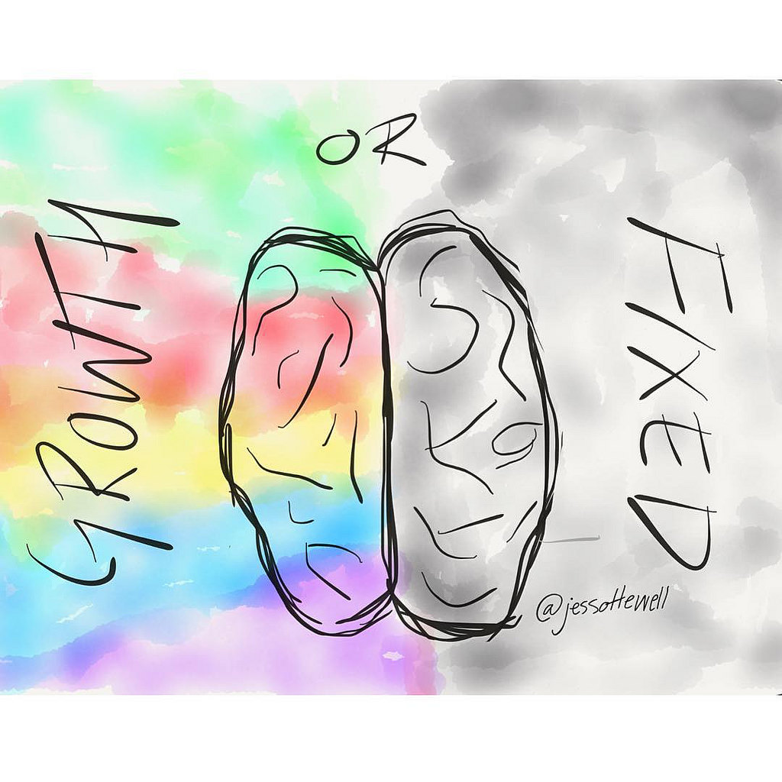
Check your mindset: challenges
Fixed mindset: I don’t like challenges and usually avoid them at all costs. I don’t want to look stupid, so what happens if I try something and get it wrong? What if I lose? I’m better off just not taking part at all.
Growth mindset: I welcome a challenge. Bring it on! Trying new things is the only way to learn. I don’t mind if I don’t get it right first time. That’s fine. I’ll get it next time or the time after that.
Notes:
The following images are free to share and use commercially:
https://www.bing.com/images/search?view=detailV2&ccid=KG9tRbI%2b&id=5D1441222195A2A1963F0892F72C776F73D4AB1E&thid=OIP.KG9tRbI-3rKNym2PmLrZzgHaHa&mediaurl=https%3a%2f%2fc1.staticflickr.com%2f1%2f256%2f19751739181_ee9f90344a_b.jpg&exph=1024&expw=1024&q=growth+mindset+fixed+mindset&simid=608012284378350850&selectedIndex=27&qft=+filterui%3alicense-L2_L3_L4&ajaxhist=0

Slide 11
Check your mindset: mistakes
Fixed mindset: Let’s not admit we make them. Let’s carry on exactly as before. And let’s definitely not ask anyone for help. Super-talented people don’t need help!
Growth mindset: Mistakes happen. They are nothing to be ashamed of and they show me exactly what I don’t know so that I can work on improving my skills.
Notes:
The following images are free to share and use commercially:
https://www.bing.com/images/search?view=detailV2&ccid=KG9tRbI%2b&id=5D1441222195A2A1963F0892F72C776F73D4AB1E&thid=OIP.KG9tRbI-3rKNym2PmLrZzgHaHa&mediaurl=https%3a%2f%2fc1.staticflickr.com%2f1%2f256%2f19751739181_ee9f90344a_b.jpg&exph=1024&expw=1024&q=growth+mindset+fixed+mindset&simid=608012284378350850&selectedIndex=27&qft=+filterui%3alicense-L2_L3_L4&ajaxhist=0

Slide 12
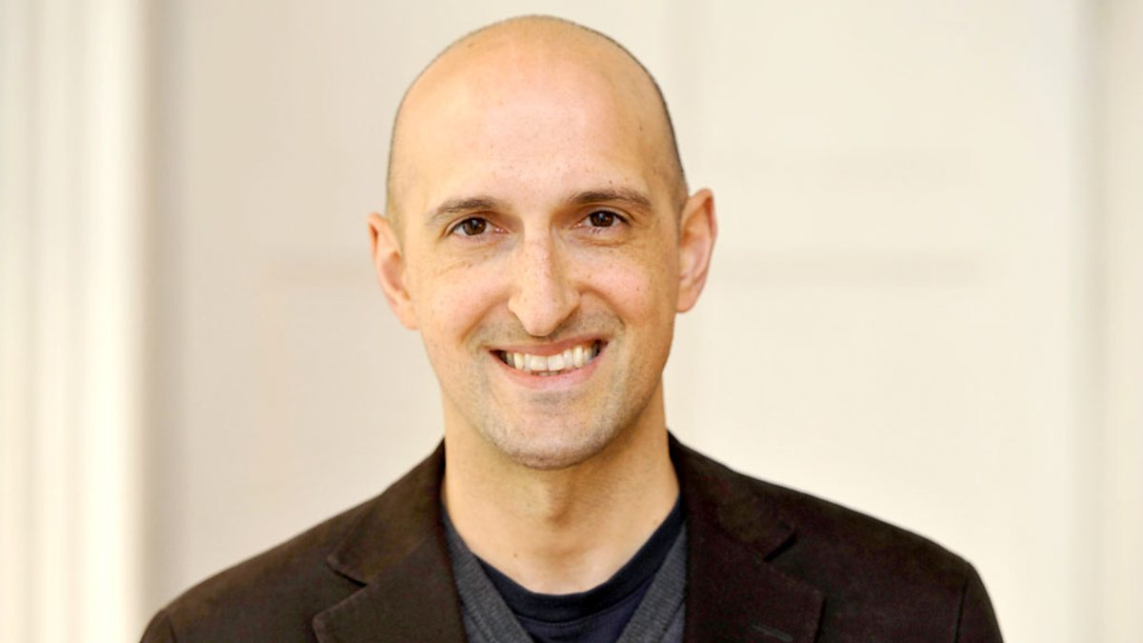
Matthew Syed

Slide 13
What next? Commit to change.
Identify a situation that you find challenging this week. Write down the obstacles that you faced.
Consciously choose to approach these obstacles positively. Notice the growth mindset phrases and attitudes that help you to do this.
Reflect on how you feel different about tackling something challenging. Be prepared to share this in the reflection session.

Slide 14
NEXT SESSION

Slide 15
YOU ARE AWESOME

Slide 16
© Year 2018 The PiXL Club Ltd and Author Matthew Syed. All rights reserved.
If this resource has been provided under The PiXL Club Ltd school membership agreement, it is strictly for the use of member schools for as long as they remain members of The PiXL Club. It may not be copied, sold, or transferred to a third party or used by the school after membership ceases. Until such time it may be freely used within the member school.
The Author Matthew Syed has the right to sell this teaching guide. It may not be copied, sold, or transferred to or by a third party. Matthew Syed takes full responsibility for all commercial activity thereof.
All opinions and contributions are those of the author. The contents of this resource are not connected with, or endorsed by, any other company, organisation or institution. Any additional images are from getty.co.uk , unless otherwise stated. 'You Are Awesome' illustrations copyright © Toby Triumph.
Endeavours have been made to trace and contact copyright owners. If there are any inadvertent omissions or errors in the acknowledgements or usage, this is unintended and PiXL will be remedy these on written notification.

