Slide 1
YOU ARE AWESOME

Slide 2
How much do you agree or disagree with each of these statements?

Slide 3
TODAY’S SESSION
YOU WILL NEED

Slide 4
While Kid Average has decided he’s no good, given up completely and gone to bed, Kid Awesome is determined and sticks to it. Kid Awesome really wants to improve. Not just by a little bit, but as far as he can take things. Kid Awesome is set on becoming the best table-tennis player he can, and he realises that this all comes down to how often he can get in the garage to practise. He starts to love the game. So much so that he has even started thinking about asking his brother to help him practise.
page 20
Notes:
Page 138

Slide 6
What does ‘awesome’ mean?

Slide 7
Read Chapter 1* of ‘You Are Awesome’.
*pages 6-32

Slide 8
I’ve had ENOUGH!
tries again and again and again
I’m no good at it.
works for hours and hours and hours
AVERAGE
AWESOME
He’s way better than me.
“I can do this. I can do this. I can do this.”

Slide 9
Kid Average
Kid Awesome
In which subjects or situations are you more like Kid Average, and in which are you more like Kid Awesome?
Notes:
© Image: Busyok Creative/Shutterstock.com

Slide 10
Make a list of your hopes and dreams. These might be ones you could achieve this week, perhaps later on this year, or a bigger dream to strive for and achieve at a later point in your life.
E.g. playing the piano, teaching, tennis, vlogging, chess, cooking, reading

Slide 11
What motivates you?

Slide 12
What are the first steps you need to take to achieve your dream?

Slide 13
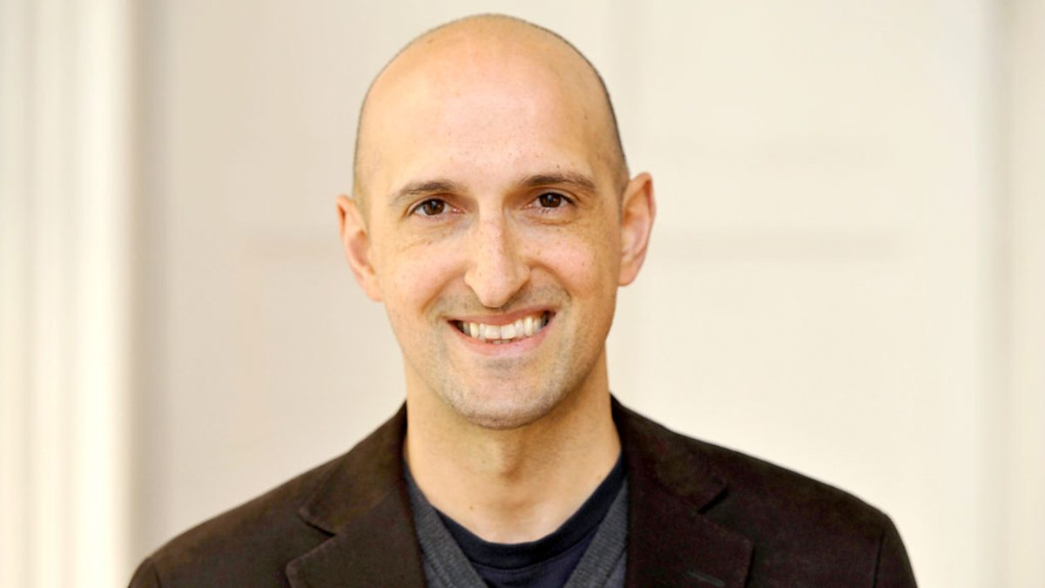
Matthew Syed

Slide 14
What next?
Quiz your friends and family: find out what big choices they’ve had to make in their lives.
When have they taken the tougher route?
What did the tougher road look like?
What did their success look like at the end?

Slide 15
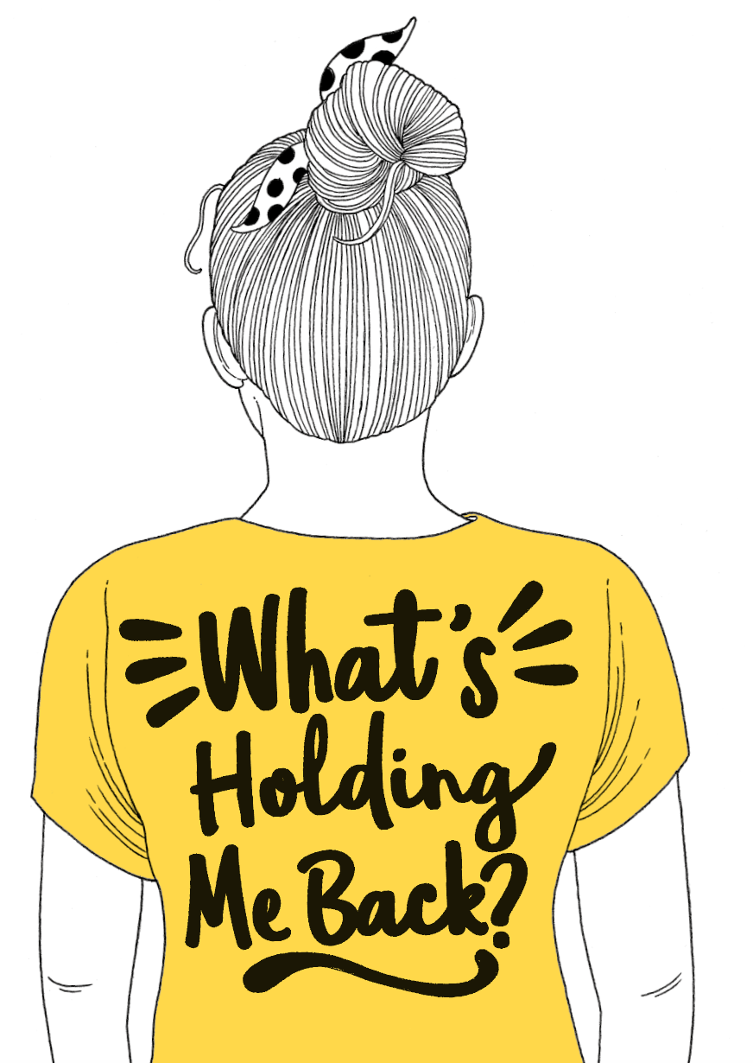
NEXT SESSION

Slide 16
YOU ARE AWESOME

Slide 17
© Year 2018 The PiXL Club Ltd and Author Matthew Syed. All rights reserved.
If this resource has been provided under The PiXL Club Ltd school membership agreement, it is strictly for the use of member schools for as long as they remain members of The PiXL Club. It may not be copied, sold, or transferred to a third party or used by the school after membership ceases. Until such time it may be freely used within the member school.
The Author Matthew Syed has the right to sell this teaching guide. It may not be copied, sold, or transferred to or by a third party. Matthew Syed takes full responsibility for all commercial activity thereof.
All opinions and contributions are those of the author. The contents of this resource are not connected with, or endorsed by, any other company, organisation or institution. Any additional images are from getty.co.uk , unless otherwise stated. 'You Are Awesome' illustrations copyright © Toby Triumph.
Endeavours have been made to trace and contact copyright owners. If there are any inadvertent omissions or errors in the acknowledgements or usage, this is unintended and PiXL will be remedy these on written notification.

