Slide 1
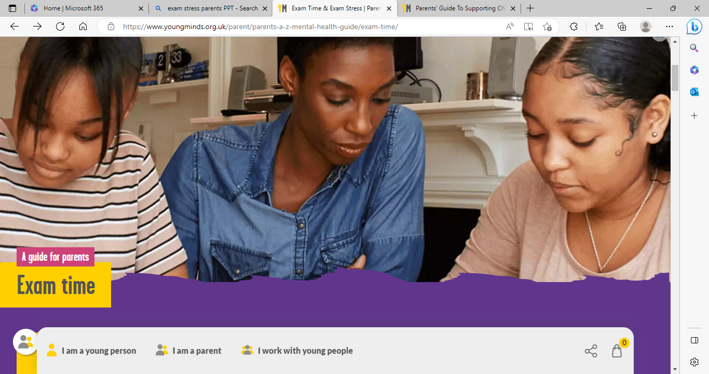

Slide 2
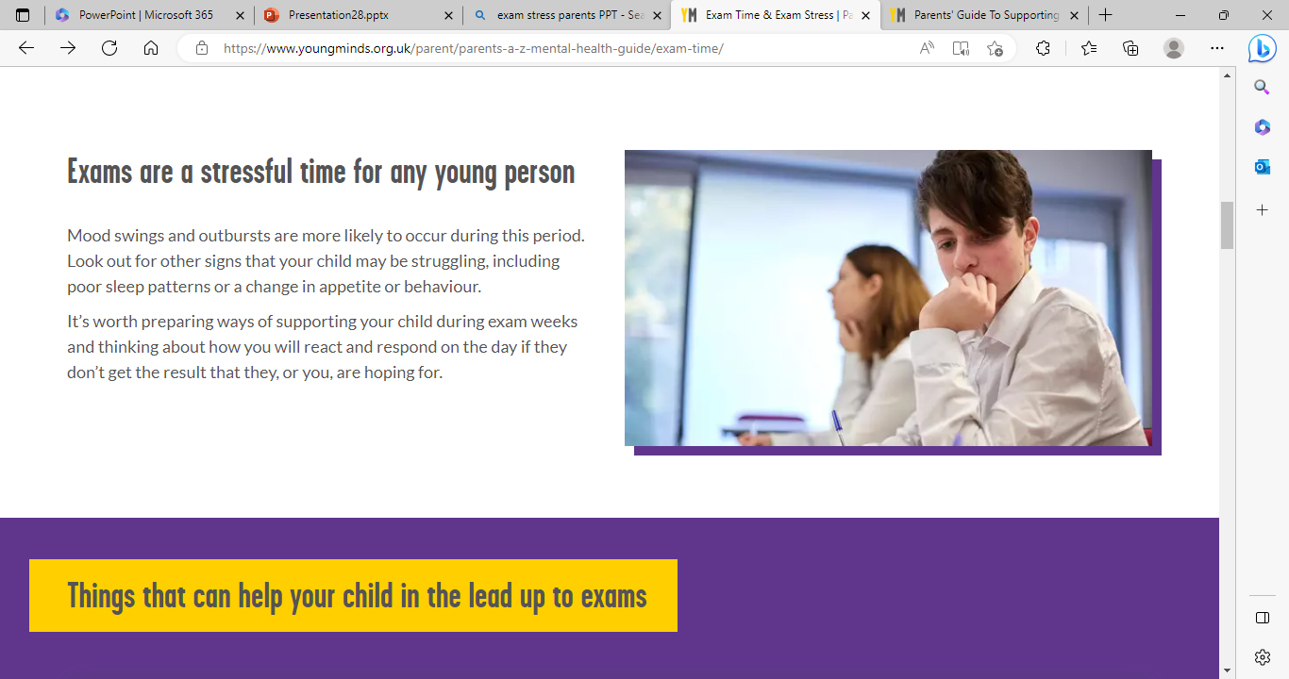
Mood Swings and outbursts are more likely to occur during this period.
Look out for other signs that your child may be struggling, including poor sleep patterns or a change in appetite or behaviour
It's worth preparing ways of supporting your child during the exam weeks and thinking about you will react and respond on exam days.

Slide 3
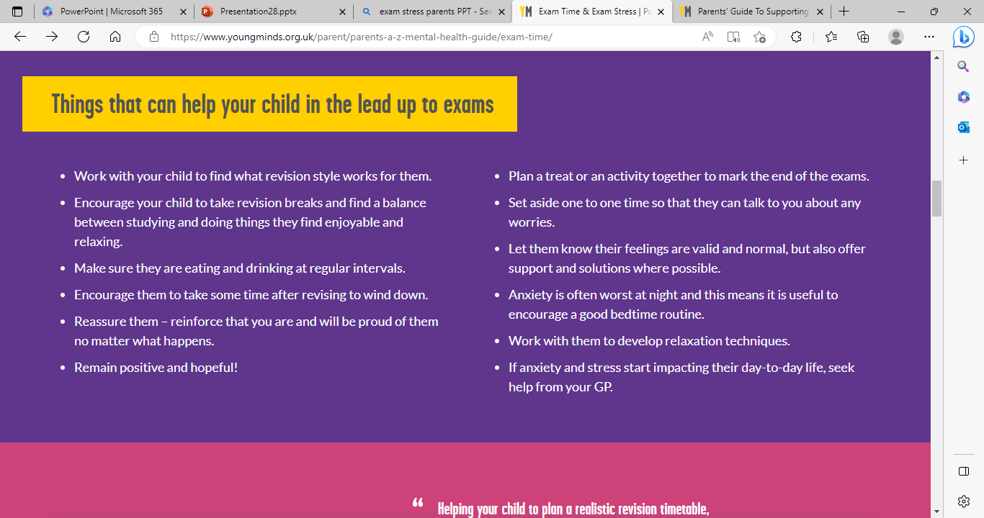
Work with your child to plan a revision timetable and encourage them to stick to it. Ask them about topics they have revised
Encourage your child to take revision breaks and find a balance between studying and doing things they find enjoyable and relaxing.
Make sure they are eating and drinking at regular intervals.
Encourage them to take some time after revising to wind down.
Reassure them that what they are feeling is normal and valid, but also offer support and solutions.
Anxiety is often worst at night and this means it is useful to encourage a good bedtime routine without social media or games console
Avoid saying that it doesn't matter – to them it does. Set aside 1:1 time to listen to them
Remain positive and hopeful!

Slide 5
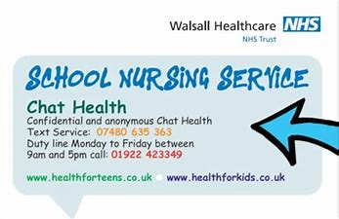
Remember if you need to talk or ask anything else about todays session, there are lots of places and people you can reach out to.
Form tutor, HoY, SLT, DOLs, class teacher

