Slide 1
Prepare to Perform
Year 11 support March-may

Slide 2
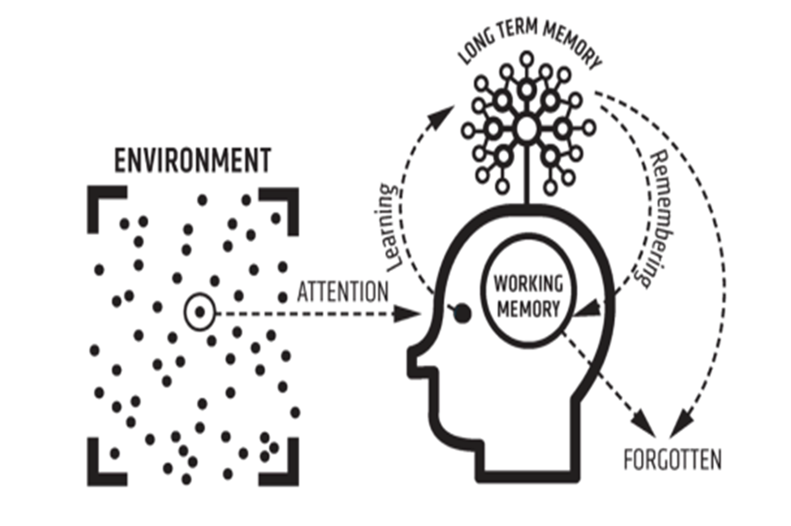
Empowering your brain
KEEP HYDRATED
EAT WELL
SLEEP WELL
EXERCISE

Slide 3
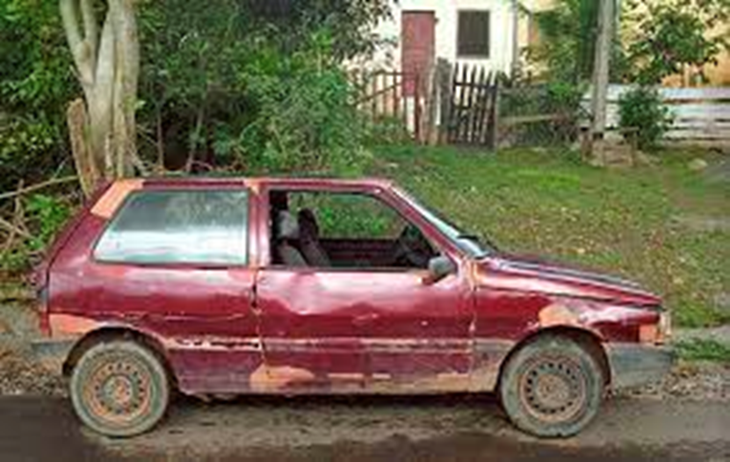
Empowering your brain

Slide 4
Empowering your brain
Long term memory: 3 time rule

Slide 5
How your teachers will support you
Focus on
Key content and skill strengths and weaknesses/areas to develop
‘Re-teach/teach’ content
Provide study support (revision, exam questions, additional classes, exam stamina training and resources)

Slide 6
5 pupil Prepare to Perform Strategies
Focus on
*Complete the course content (understanding and learn)
*Finalising subject notes
Making a life timetable each week to organise time and plan in study time
Revision strategies A. Condensed notes. B. Making mind-maps to visually organise knowledge and skills. B. Using cue cards to test key learning
Application of learning (practice questions/papers, online practice, e.g. on GCSE pod, subscription website, impress the examiner)
If points 1 and 3 are not complete, points 2, 4 and 5 are harder to achieve. Point 3 makes learning more organised, more effective/efficient and less stressful. Point 5 is essential to be exam ready. Point 5 is only possible if points 1, 2 and 4 have been engaged. Point 3 makes points 1, 2, 4 and 5 achievable whilst having time out to relax and switch off

Slide 7
Building big write stamina- Your Self-Training Programme
Write untimed, all notes, revision guides and classwork available
Write timed, all notes, revision guides and classwork available
Write untimed- limited or no notes
Write timed- limited or no notes

Slide 10
Building big write stamina

Slide 11
Switch off the mobile phone and social media when studying
De-clutter your study space
Building big write stamina

Slide 12
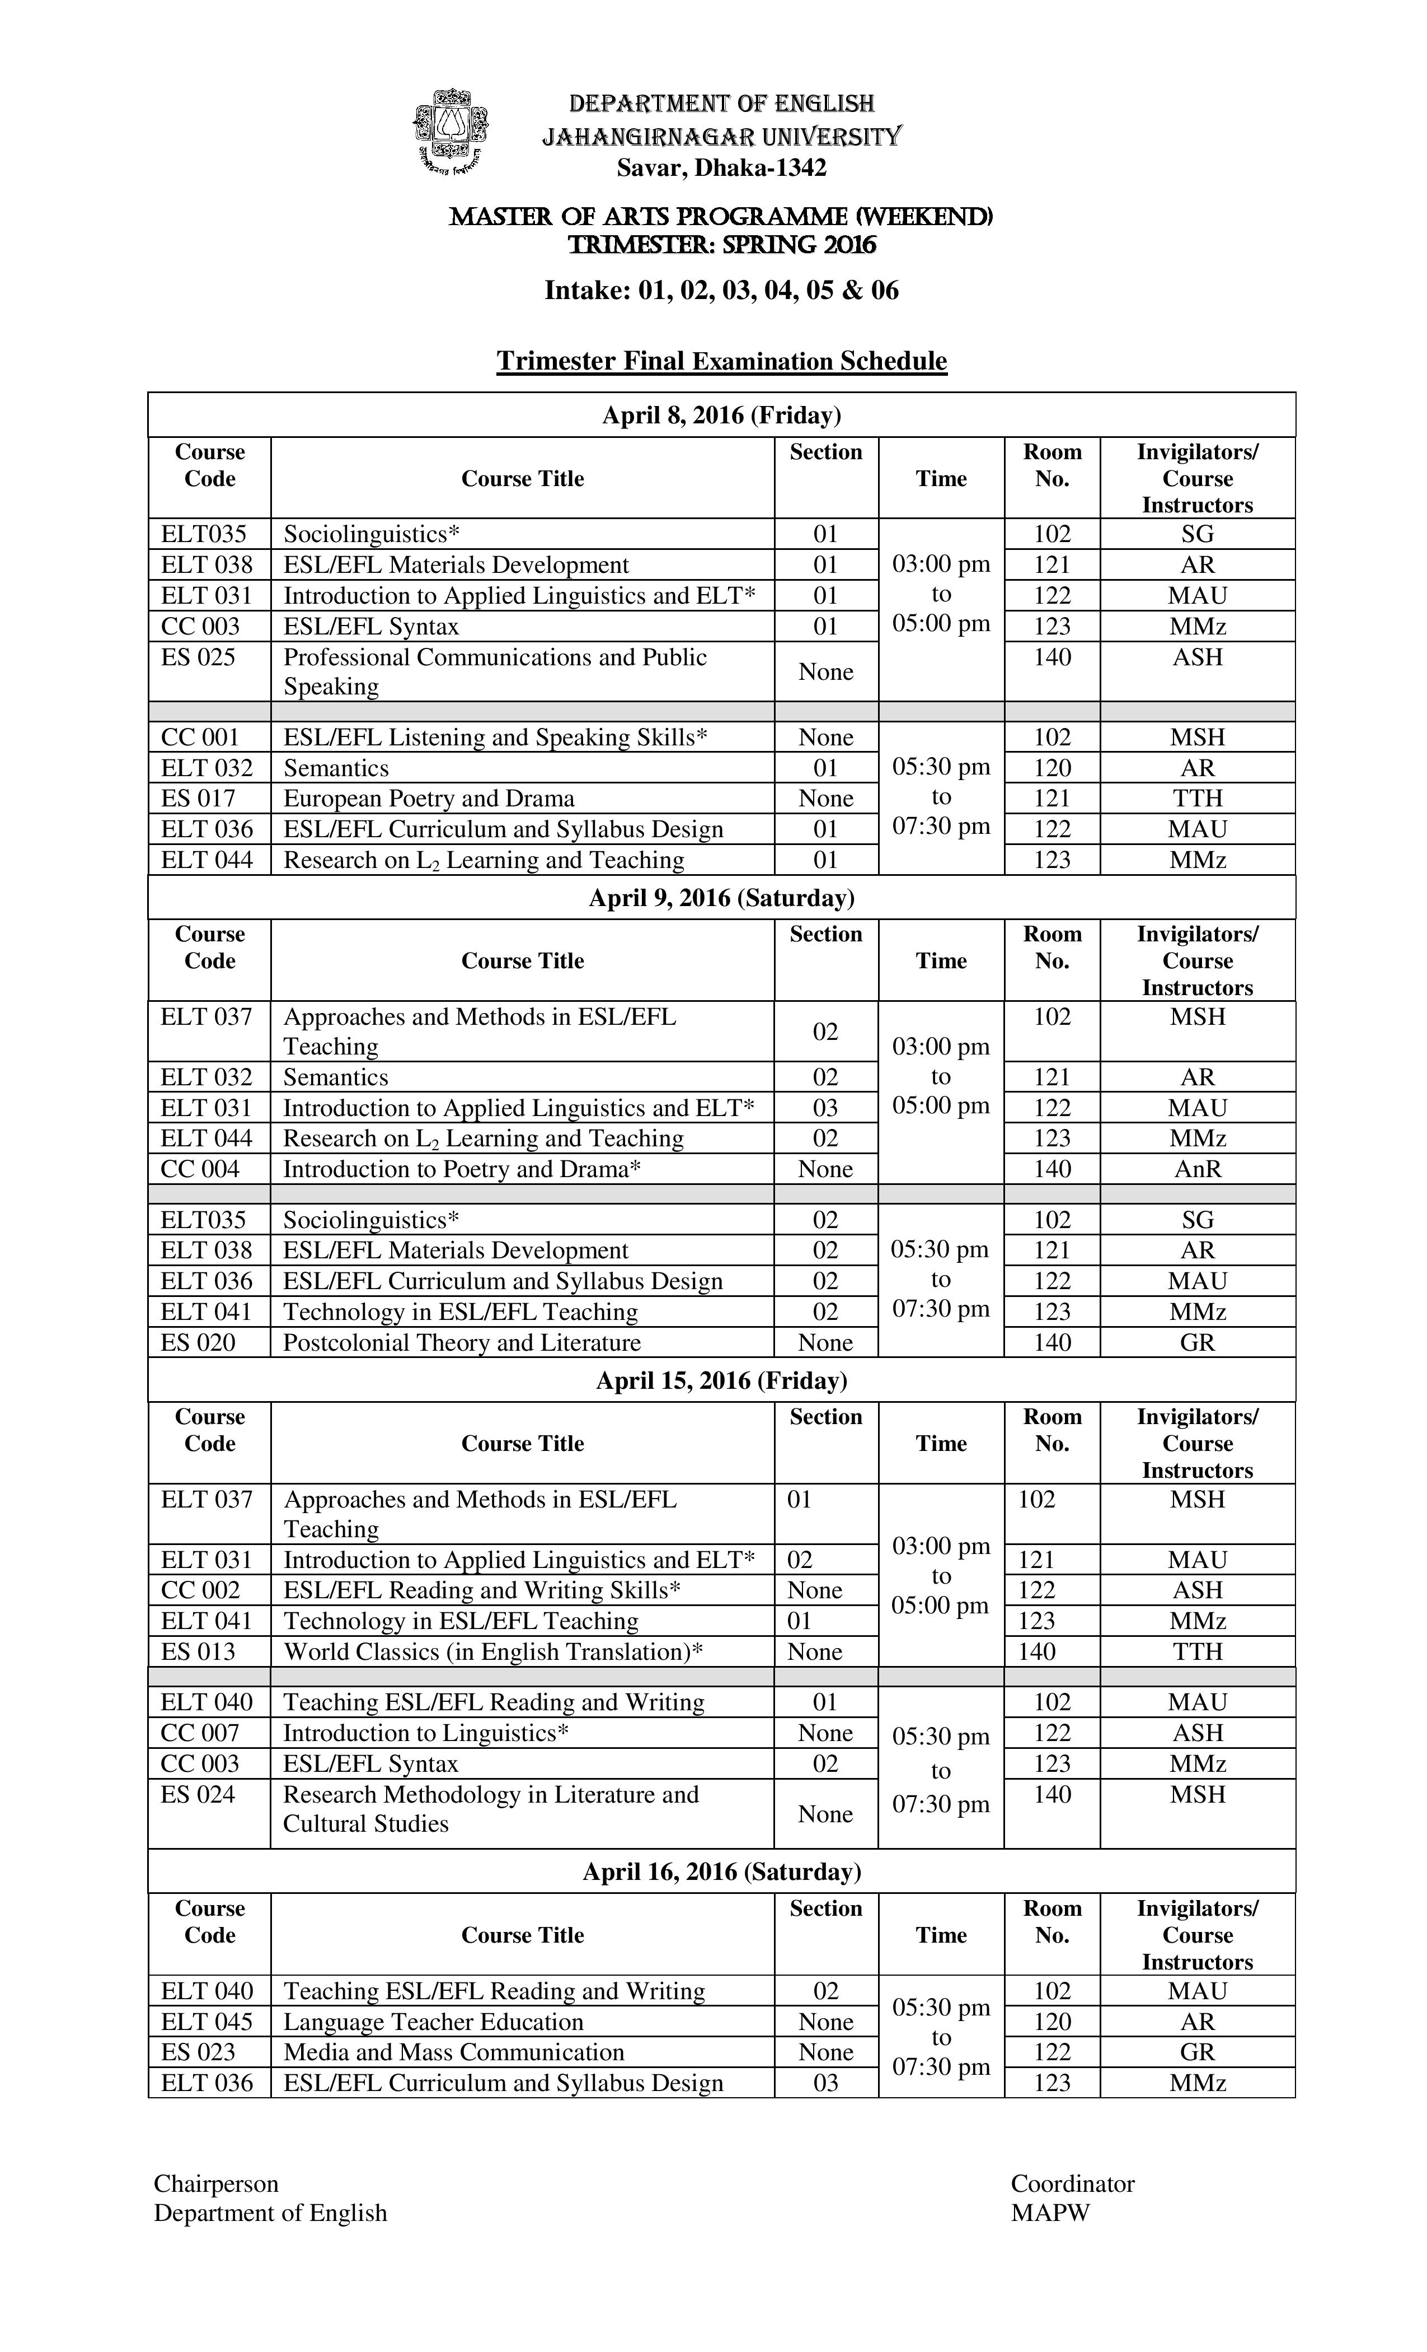
Keep a copy of your child's life timetable and exam timetable handy

Slide 13
Staff are here to help

Slide 14
You have time and you can do it- you can be successful in the final exams.

