Slide 1
AQA GCSE Science
The last few months to prepare
Exam date | Content
16th May | Biology paper 1 | Cell Biology; Organisation; Infection and response; and Bioenergetics.
22nd May | Chemistry paper 1 | Atomic structure and the periodic table; Bonding, structure, and the properties of matter; Quantitative chemistry; Chemical changes; and Energy changes.
25th May | Physics paper 1 | Energy; Electricity; Particle model of matter; and Atomic structure.
9th June | Biology paper 2 | Homeostasis and response; Inheritance, variation and evolution; and Ecology
13th June | Chemistry paper 2 | The rate and extent of chemical change; Organic chemistry; Chemical analysis; Chemistry of the atmosphere; and Using resources.
16th June | Physics paper 2 | Forces; Waves; and Magnetism and electromagnetism (and Space for separate physics)
Combined science papers are 1 hour 15 minutes and out of 70 marks
Separate science papers are 1 hour 45 minutes and out of 100 marks

Slide 2
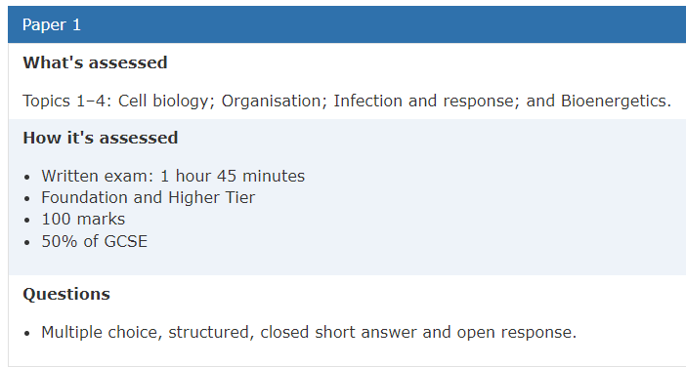
What can you do to prepare?
Know your exam board
Know your specification
Know what is in each exam
Use the resources teachers have made for you
https://www.aqa.org.uk/subjects/science/gcse/combined-science-trilogy-8464/specification-at-a-glance
https://www.aqa.org.uk/subjects/science/gcse/biology-8461/specification-at-a-glance
https://www.aqa.org.uk/subjects/science/gcse/chemistry-8462/specification-at-a-glance
https://www.aqa.org.uk/subjects/science/gcse/physics-8463/specification-at-a-glance

Slide 3
What can you do to prepare?
Take your exercise book home, use it when you revise.
Come to lessons with the attitude that you want to get the most out of the 60 minutes you have.
Actively participate in lessons.
Complete paper-based home learning activities.
Complete online home learning activities.
Start revising now if you haven’t already – use the booklets you have been given to guide your revision
Use the summary contents table provided by your teachers to plan independent revision.

Slide 4
What can you do to prepare?
Use the specification to divide your revision over your available time, give extra time to more difficult topics.
Use a range of different revision materials so your don’t get bored.
Past papers AQA | Find past papers and mark schemes
Online platforms: Seneca learning, Quizlet, BBC bitesize, Primrose kitten quizzes, Primrose kitten videos, Physics and Maths tutor, Cognito - YouTube
Revision guides and knowledge organiser booklets
Read/cover/repeat, retrieval mind maps, mnemonics, flash cards

Slide 5
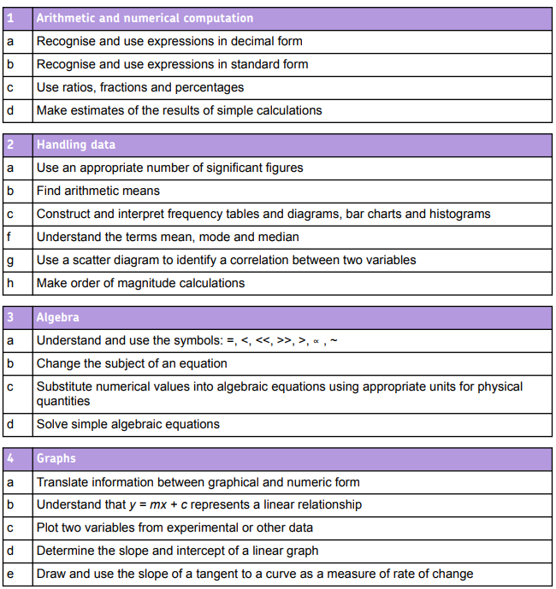
What can you do to prepare?
Know definitions for easy marks (retrieval practice).
Understand command words: List, name, describe, explain, evaluate, compare, use determine so you don’t miss out on marks by answering in the wrong way.
Practice answering long answer questions, so you are confident in the exam.
Know the required practicals inside out!
Practice the math skills required for the exams.
Page 171 of CS spec/

