Slide 1
Mathematics
Mrs Huskisson
Head of Maths
jhuskisson@brownhillsoa.co.uk

Slide 2
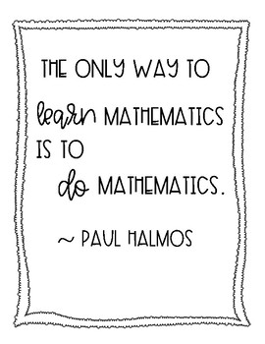
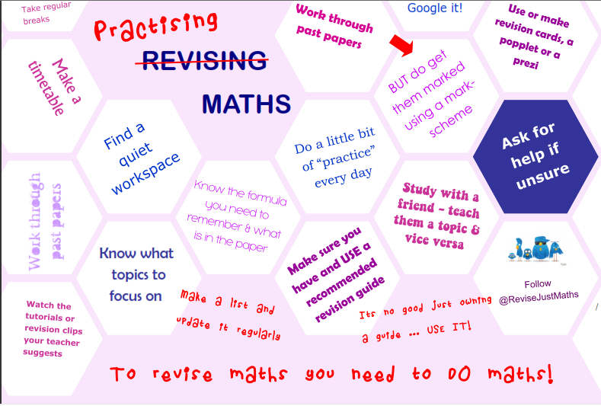
Friday
19th May
Tuesday
6th June
Wednesday
14th June

Slide 3
When can students practice Maths?
In lesson
In Maths focus sessions; form time or Monday period 1
Wednesday masterclass afterschool
Sparx homework
Exam paper homework
Independent revision

Slide 4
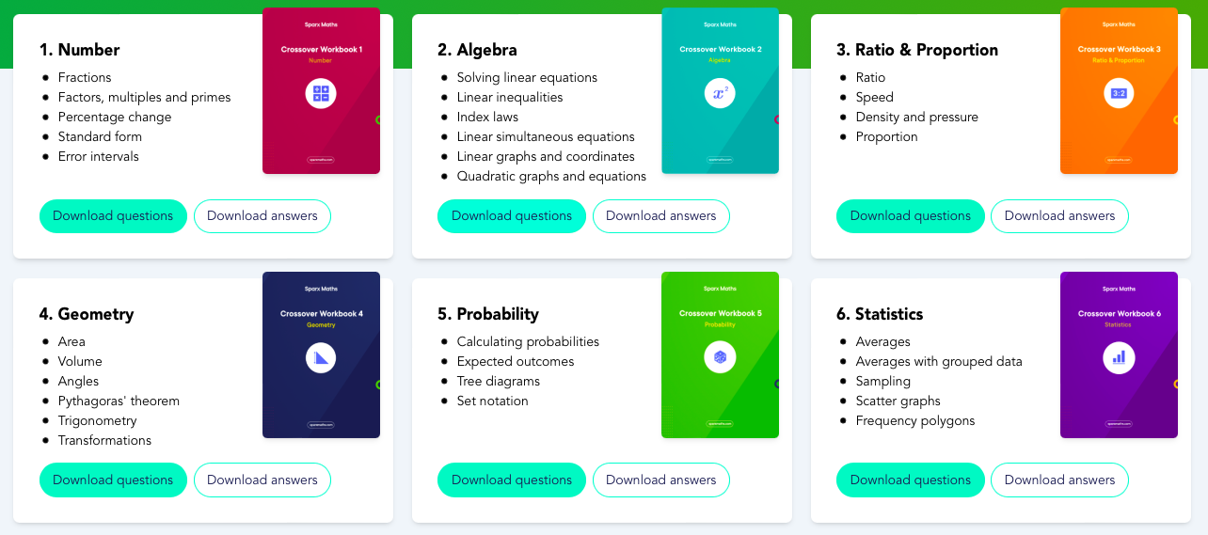
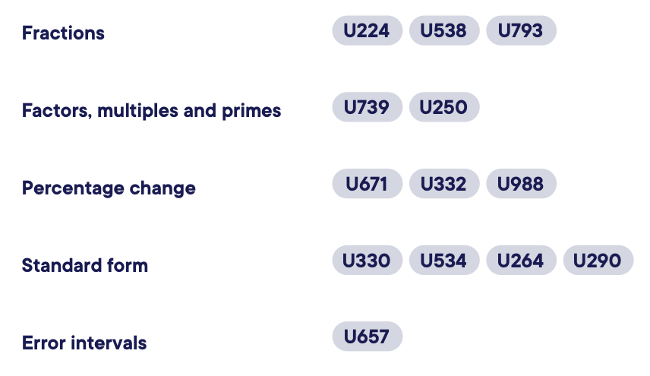
Sparx workbooks

Slide 5
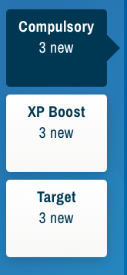
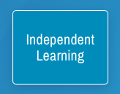
Home learning: sparx.co.uk

Slide 6
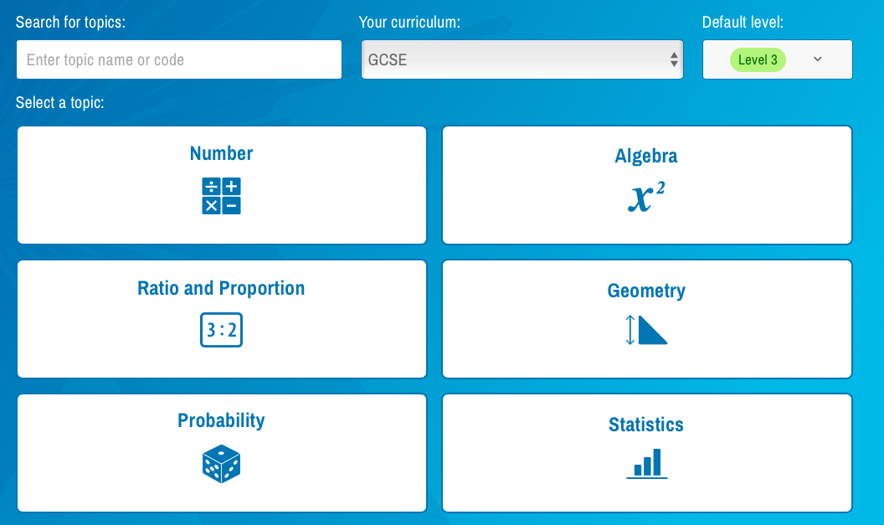
Home learning: sparx.co.uk

Slide 7
How can you support at home?
Encourage students to complete their Sparx home learning in good time
Support attendance at Masterclasses
Provide a scientific calculator for use at home
Encourage independent practice of exam papers
Quiz them on key facts
Use the QLA’s after the exams to guide revision of key areas
Mark their work
Sparx maths corbettmaths onmaths

Slide 8
Taking responsibility for your learning
What should students be doing?
Your exam
Your education
Your future

