Slide 1
GCSE History
Mrs Ashman

Slide 2
When are the history exams?
Paper | Topic | Length | % | Date
1 | Crime and Punishment c1000—2000 Including the Whitechapel environment study. | 1 hour 15 | 30 | 18th May 2023 (am)
2 | Early Elizabethan England, 1558–88 AND Superpower relations and the Cold War, 1941–91. | 1 hour 45 | 40 | 7th June 2023 (pm)
3 | Weimar and Nazi Germany, 1918–39 | 1 hour 20 | 30 | 15th June 2023 (am)
All exam papers have a range of questions that address the 4 assessment objectives within them.
All start with 4 mark questions and then develop to 12 mark questions with our longest most demanding questions being worth 20 marks.
Paper 2 has two large topics within them: Super power relations and the Cold war and Early Elizabethan England.

Slide 3
GCSE History
Your child will soon be sitting three GCSE History exams. There is no longer any controlled assessment in GCSE History. The exams test the following four skills:
AO1 Demonstrate knowledge and understanding of the key features and characteristics of the periods studied.
AO2 Explain and analyse historical events and periods studied concepts.
AO3 Analyse, evaluate and use sources to make substantiated judgements, in the context of historical events studied.
AO4 Analyse, evaluate and make substantiated judgements about interpretations (including how and why interpretations may differ) in the context of historical events studied.

Slide 4
GCSE History
Exam success for history students is based on three basic yet important things:
Regular homework being completed.
Parental support and encouragement.
Completed classwork.

Slide 5
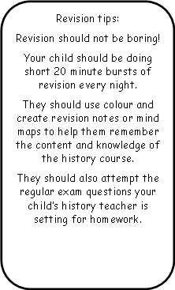
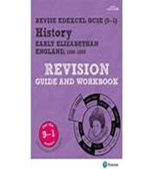
Revision and homework
Useful websites for students to use to revise the knowledge and content of the course:
Crime and Punishment topic:
https://www.bbc.co.uk/education/topics/z3gg87h/resources/1
https://getrevising.co.uk/revision-notes/history_crime_and_punishment
Early Elizabethan England, 1558–88:
https://www.bbc.co.uk/bitesize/guides/zyr6bk7/revision/1
https://www.youtube.com/playlist?list=PLi4H3ltY8QTLDJyBWyXEBXCH8RKwyGF1C
Superpower relations and the Cold War 1941–91:
https://www.bbc.co.uk/bitesize/guides/z8fwhv4/revision/1
https://www.youtube.com/watch?v=TMYcLVDAeD4&list=PLxblrnocOkdWzXWZtjNK8VGkWjWDoKtR4
Weimar and Nazi Germany, 1918–39:
https://www.bbc.co.uk/bitesize/guides/zt9v7hv/revision/1
https://www.totallytimelines.com/weimar-and-nazi-germany-1918-1945/

Slide 6
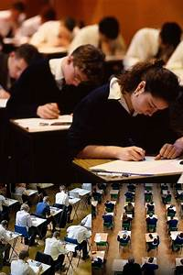
Exam Questions
The students are familiar with the exam papers.
Edexcel, our exam board, asks various Questions. They start with 4 mark Questions, 8, 12 and then the students have a 16 mark question to answer where they are expected to write an extended answer.
This exam board does give the students stimulus points to help them answer their questions. The idea is that they use the stimulus points to help structure their written answers.
An example of a 16 mark question would be:
Question 5: ‘Punishments were terrifying and harsh in order to deter criminals throughout the period c.1000-1700.’ How far do you agree?
You may use the following in your answer:
Capital Punishment
Deterrence
You must also use your own knowledge
16 marks

Slide 7
How can you help your child?
It is important that you help and support your child at this important time of study.
Ideally your child needs to have a quiet area to revise and study at home.
The best preparation for the history exams is revision and exam practise. Your child will be set an exam question to practise every week for homework.
It is so important that your child completes their homework on time and gets feedback from their teachers on how to improve their exam answers.
Intervention is currently taking place after school. Please encourage your child to attend. In intervention we will be looking at how the student can improve their written work and historical knowledge.
Regular testing of knowledge will take place as well as answering exam questions and unpicking the mark schemes so as students understand how to achieve top marks.
If you have any questions do not hesitate to contact your child’s History teacher:
Mrs Ashman or Mrs Adams .

Slide 8
Revision guides
The best revision guides for GCSE history are the ones written for the Edexcel specification.
The best revision guides usually offer a mix of knowledge and exam practise.
The ones that we are using in class and in revision are the Revise Edexcel GCSE (9-1) History Revision Guide and Workbook.
The ISBN numbers for the revision books are:
Crime and punishment: 978-1292169705
Early Elizabethan England: 978-1292169712
Super Power relations and the cold war:
978-1292169750
Weimar and Nazi Germany: 978-1292169736
There are other history revision guides available.
Please ensure if you are considering purchasing one that they cover the correct historical topics.

Slide 9
Past Exam Papers
There are examples of the History GCSE papers here this evening.
Please take one and encourage your child to start revising and preparing for the final exams now.
Any Questions?
If you don’t want to ask now please see your history teacher for specific help and support.

