Slide 1
Oxbridge Scholars
HoS Network
24th January 2023

Slide 2
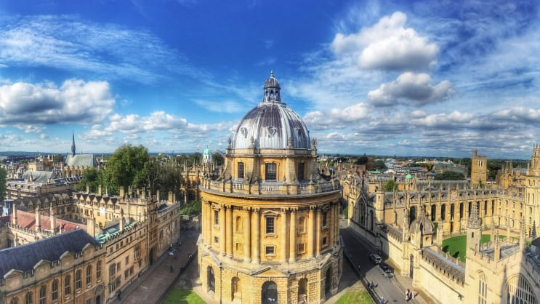
Oxbridge Scholars Programme
For Year 12 pupils aspiring to attend Oxbridge to maximise their chances of a successful application
Funding for 14 pupils to take part in the programme
Additional events for all Year 11 and Year 12 pupils (no limit on numbers)

Slide 3
The Programme: All Year 11 and Year 12 students
Monday 27th February 2023 3.30pm – 4.30pm | ‘Aspiring to Oxbridge’ talk Designed to be an initial introductory talk to introduce you to the process and what you would be expected to do as part of an application to Oxford or Cambridge, as well as factors that you should consider in deciding to apply. It also shares how to be strategic to maximise success. Attendees will have the opportunity to ask questions to the expert team members. Parents can also attend this session. A virtual meeting link will be made available to staff at your school, to organise attendance.
Wednesday 3rd May 2023 3.30pm – 4.30pm | Personal Statement presentation In this session, students will learn how to write the best possible Oxbridge personal statement. It gives students a comprehensive, detailed walk-through of how to write their personal statements. A one-hour virtual event. A virtual meeting link will be made available to staff at your school, to organise attendance.
Free
No limit to numbers
Virtual events

Slide 4
The Programme:
Oxbridge Scholars only
Thursday 6th June 2023 | Admissions Test Day This day allows students to get focused and is an interactive approach to learning the skills needed to succeed in the admissions test. A day event, it involves 3-4 hours of group tutorials focusing on different sections of the test. Then students will sit a specially designed Oxbridge Applications Mock Paper which will be marked for them. This will be held virtually
Friday 15th September 2023 | Campus Open Day Students will have the opportunity to visit the University of their choice, either Cambridge or Oxford, with Rachel McCarthy (Oxford) or Klara Reddy (Cambridge)
October 2023 Date TBC | Interview Preparation Day This day is designed for students to gain confidence in the skills needed for interviews and brush up on their subject knowledge. This is a full day intensive course consisting of interview practice, subject knowledge tutorials, and a talk from a Former Oxbridge Admissions Tutor. Students will have two mock interviews (one general and then one subject specific), each with verbal and written feedback.
Notes:
Oxbridge Applications website:
- Support resources
Applications resources

Slide 5
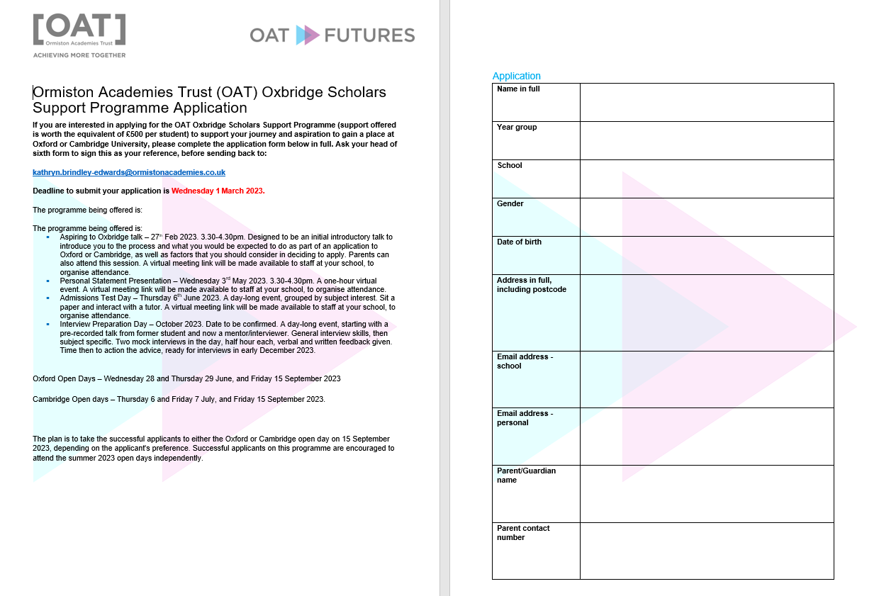

Slide 6
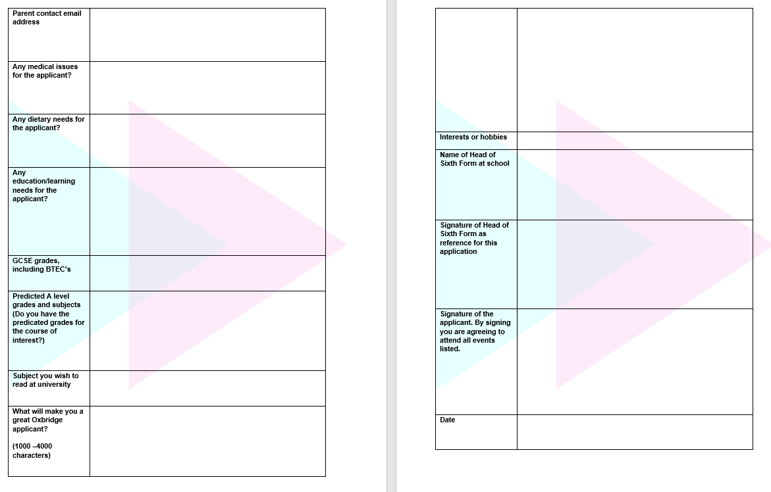

Slide 7
Next steps
Promotion of the two initial events
Communication with Careers Leaders and PD leaders
Completion of application from: deadline 1st March 2023

